Slide 1

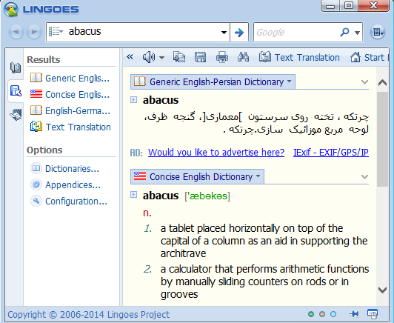
Useful Apps and websites
http://www.lingoes.net

Slide 2
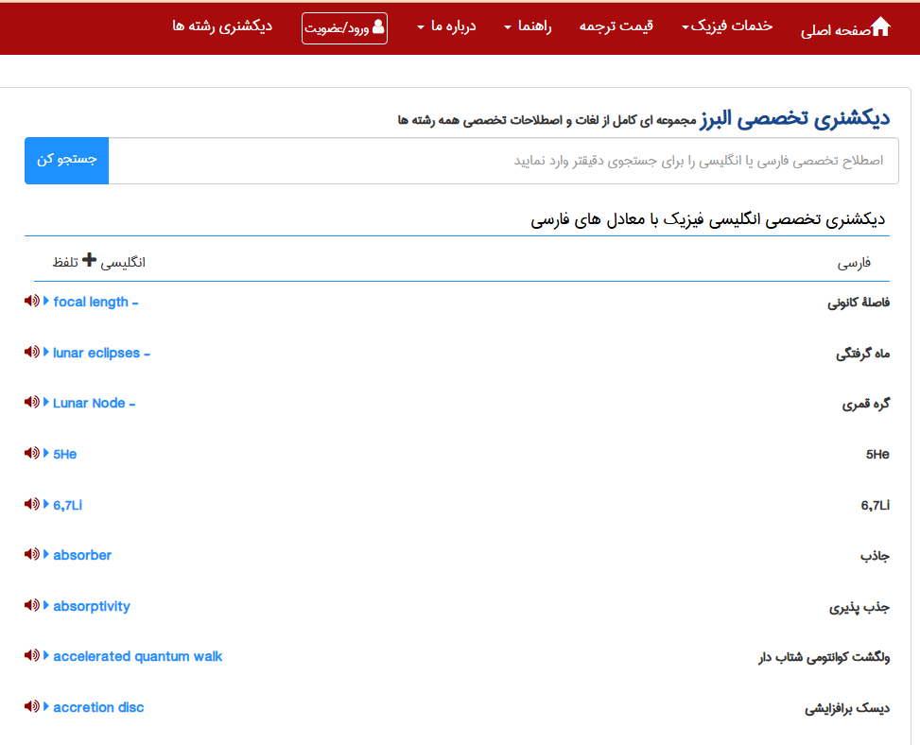
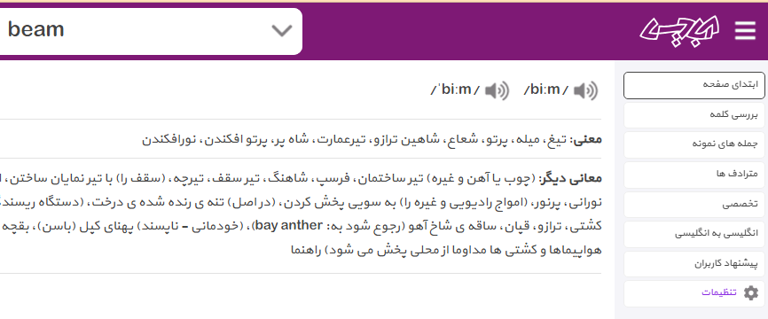
https://abadis.ir/
https://www.ir-translate.com/PU/Dictionary/

Slide 3
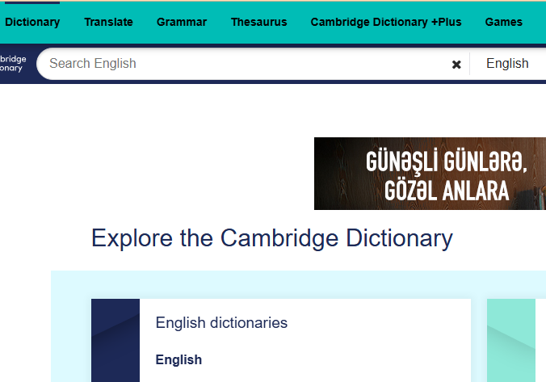
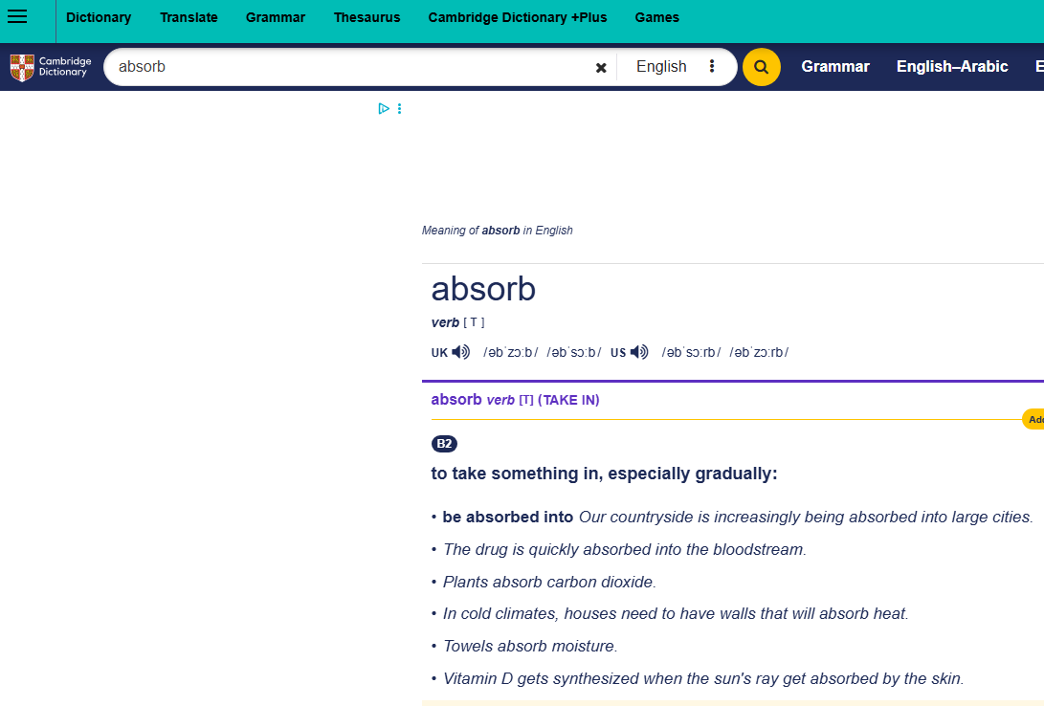
https://dictionary.cambridge.org/

Slide 4

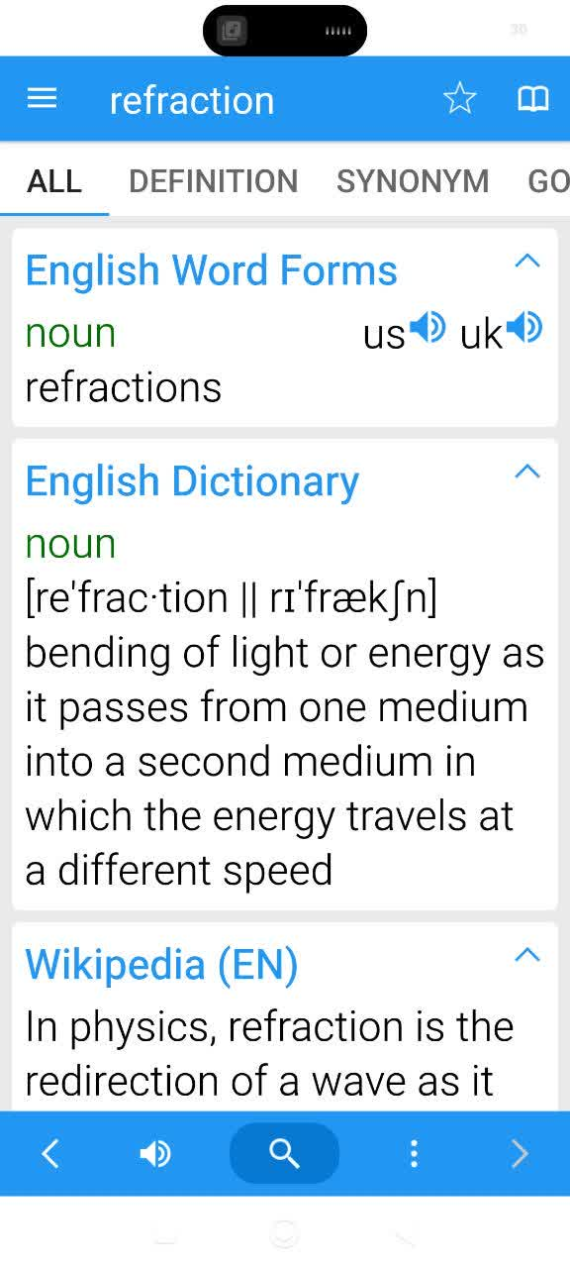
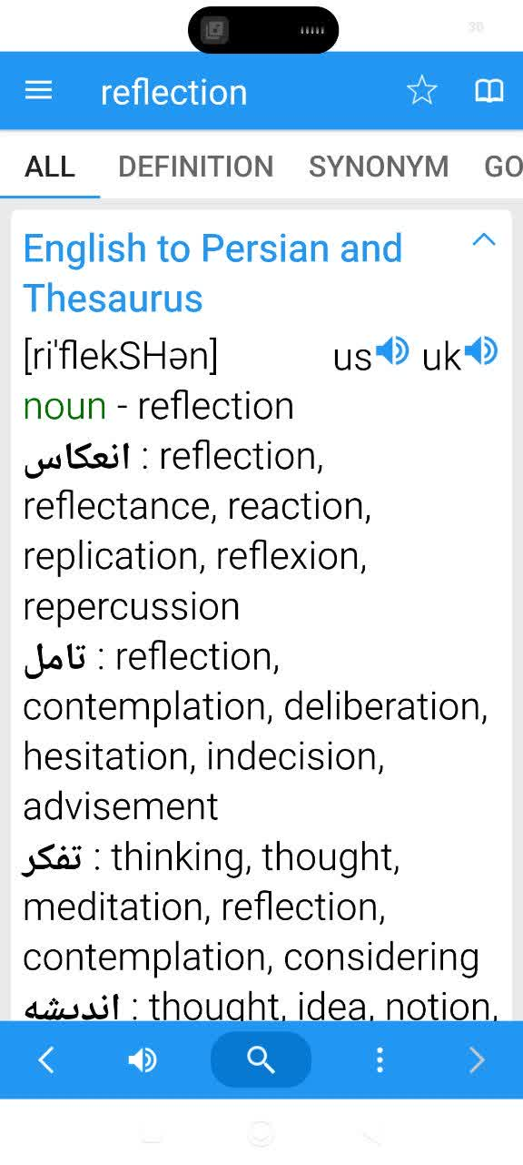

Slide 5
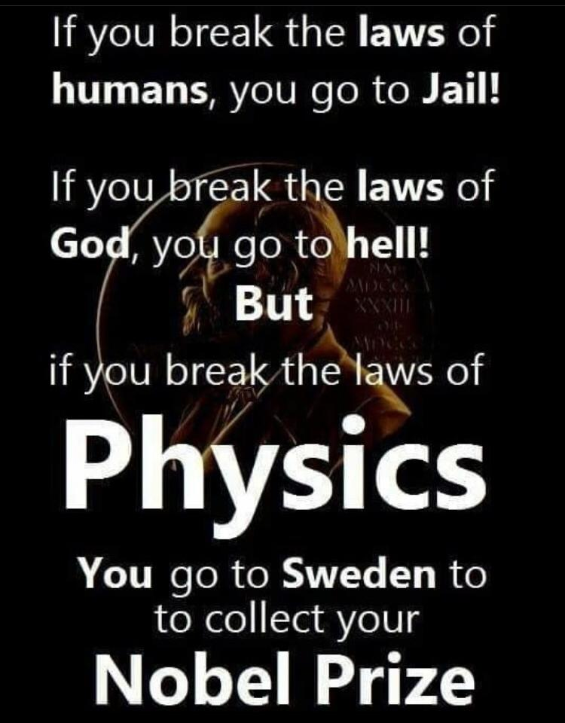

Slide 6

Presence of many English words in Persian with
French, German or Farsi pronunciation
Start with the more common cases:
Microscope
میکروسوپ
Television
تلویزیون
National
ناسیونال
Radio
رادیو
Machine
ماشین
Lamp
لامپ
Gear Box
گیربوکس
Telephone
تلفن
Please give some more examples

Slide 7
A few more specialized words as example
Material
متریال
Arrange
ارنج
Download
دانلود
Protocol
پروتکل
academic
آکادمیک
scholar
دانش پژوه
Please give some more examples

Slide 8
Come to some scientific words
Hydrogen
هیدروژن
Oxygen
اکسیژن
Proton
پروتون
Electron
الکترون
Neutron
نوترون
Phase
فاز
Please give some more examples

Slide 9

Some more confusing issues arrive when we think that we know
اتم
Atom
اتمی
Atomic
مولکول
Molecule
مولکولی
Molecular
محدود
Finite
نامحدود
Infinite
اقتصاد
Economy
اقتصادی
Economic
Please give some more examples

Slide 10
Once again, when we think that we know
Able
Capable
Obtainable
Probable
Measurable
Noticeable
Acceptable
Comparable
Portable
Adjustable
Sustainable
Susceptible
doable

Slide 11
Law
Low
Love

Slide 12
Some tips
listen to the pronunciation form a dictionary when you find a new word
Repeat the pronunciation several time very loudly
Find and memorize all words with the same root
Instead a single word memorize a short sentence consisting that word

Slide 13
Learn the all related words simultaneously
Measure (verb, noun)
Measured (adjective)
Measurement (noun)
Measurable (adjective)
Measurability (noun)
Measureless (adjective)
Measure up (verb)
Compare
Comparing
Comparison
Comparative
Comparability
Comparator
Compered
Comparable
Radiate
Radiation
radiational
Radiative
Radiator
Radio
Radioactive

Slide 14
Basics
Number 123 has three digits; 1, 2 and 3
50000000=5*10⁷(scientific notation) 5 into 10 raised to 7, 5 into 10 to the power 7
The digit 5 is called ‘coefficient’ and the digit 7 is called ‘exponent’
45.21 is a decimal number. The point is called ‘decimal point’
Addition & Summation
2+3=5 two plus three equals five, two plus three is five
Subtraction
11-4=7 eleven minus 4 equals seven
Multiplication
6*8=48 6 times 8 equals 48, 6 multiplied by 8 equals 48
6 and 8 are called the ‘factors’ and the answer 48 is called the ‘product’
Division
126/3=42 126 divided by 3 equals 42
126 is called ‘dividend’ 3 is called ‘divisor’ and the result 42 is called ‘quotient’

Slide 15
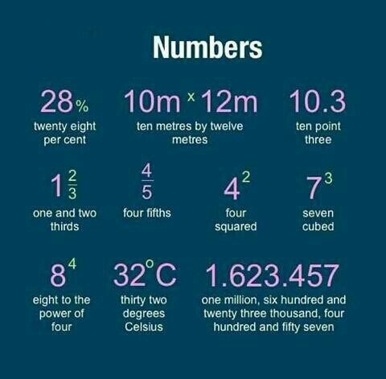
Mr. Hemmatzadeh

Slide 16
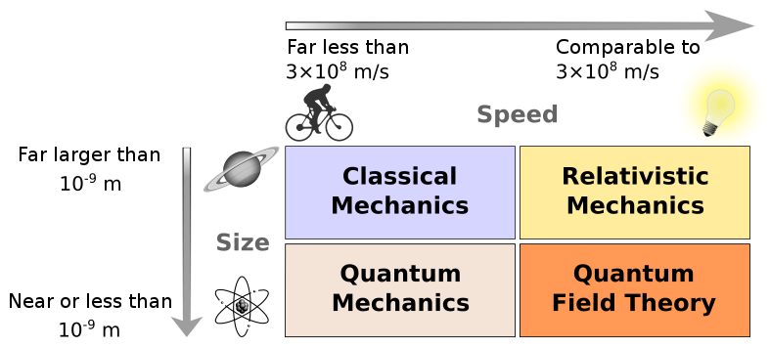
Statics is the branch of mechanics that is concerned with the analysis of loads (force and torque, or "moment") acting on physical systems that do not experience an acceleration (a=0), but rather, are in static equilibrium with their environment.

Slide 17
Kinematic: is the branch of classical mechanics which describes the motion of points (alternatively "particles"), bodies (objects), and systems of bodies without consideration of the masses of those objects nor the forces that may have caused the motion.
Mechanics: is an area of science concerned with the behaviour of physical bodies when subjected to forces or displacements, and the subsequent effects of the bodies on their environment.
Classical mechanics: is one of the two major sub-fields of mechanics, along with quantum mechanics. Classical mechanics is concerned with the set of physical laws describing the motion of bodies under the influence of a system of forces
Quantum mechanics: including quantum field theory, is a branch of physics which is the fundamental theory of nature at small scales and low energies of atoms and subatomic particles
Dynamics: is a branch of applied mathematics (specifically classical mechanics) concerned with the study of forces and torques and their effect on motion, as opposed to kinematics, which studies the motion of objects without reference to its causes.

Slide 18
Atomic physics is the field of physics that studies atoms as an isolated system of electrons and an atomic nucleus.
Nuclear physics is the field of physics that studies atomic nuclei and their constituents and interactions. The most commonly known application of nuclear physics is nuclear energy generation.
Solid-state physics is the study of rigid matter, or solids, through methods such as quantum mechanics, crystallography, electromagnetism, and metallurgy. It is the largest branch of condensed matter physics. Solid-state physics studies how the large-scale properties of solid materials result from their atomic-scale properties.
Optics is the branch of physics which involves the behavior and properties of light, including its interactions with matter and the construction of instruments that use or detect it
laser is a device that emits light through a process of optical amplification based on the stimulated emission of electromagnetic radiation. The term "laser" originated as an acronym for "light amplification by stimulated emission of radiation".

Slide 19
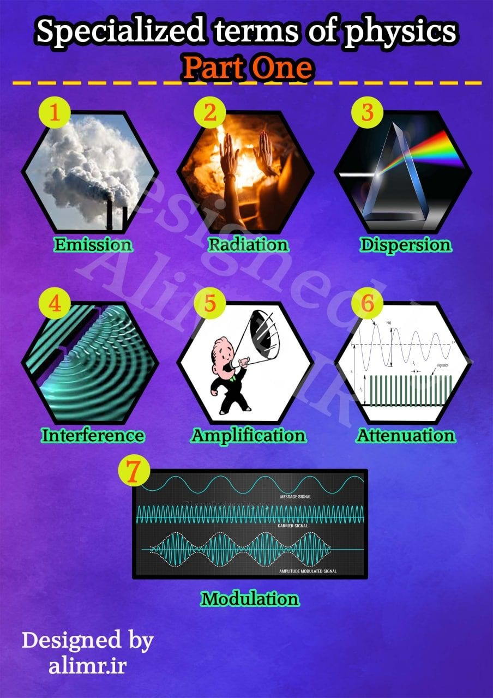
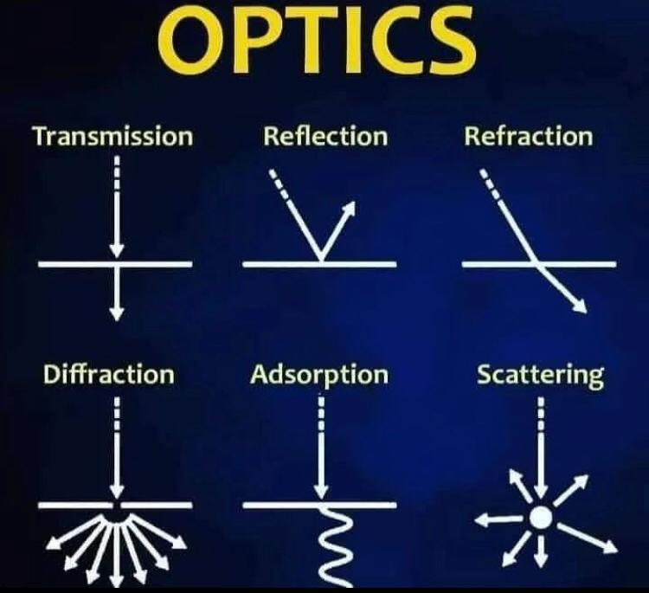
Mr. Ruzbahani

Slide 20
Particle physics (also high energy physics) is the branch of physics that studies the nature of the particles that constitute matter (particles with mass) and radiation (massless particles).
Elementary particle or fundamental particle is a particle whose substructure is unknown; thus, it is unknown whether it is composed of other particles or not
Thermodynamics is a branch of science concerned with heat and temperature and their relation to energy and work.
Statistical mechanics is a branch of theoretical physics using probability theory to study the average behavior of a mechanical system, where the state of the system is uncertain
Electromagnetism is a branch of physics involving the study of the electromagnetic force, a type of physical interaction that occurs between electrically charged particles
Electricity is a physical phenomenon associated with the presence of electric charge.
Magnetism is a class of physical phenomena that are mediated by magnetic fields. Electric currents and the magnetic moments of elementary particles give rise to a magnetic field, which acts on other currents and magnetic moments.

Slide 21
special relativity is the generally accepted and experimentally well-confirmed physical theory regarding the relationship between space and time.
General relativity is the geometric theory of gravitation published by Albert Einstein in 1915 and the current description of gravitation in modern physics.
Gravity is a natural phenomenon by which all things with mass are brought toward (or gravitate toward) one another, including planets, stars and galaxies.
Astronomy is a natural science that studies celestial objects and phenomena. It applies mathematics, physics, and chemistry, in an effort to explain the origin of those objects and phenomena and their evolution.
Biophysics is an interdisciplinary science that applies the approaches and methods of physics to study biological systems.
Geophysics is a subject of natural science concerned with the physical processes and physical properties of the Earth and its surrounding space environment, and the use of quantitative methods for their analysis.
Medical physics is the application of physics concepts, theories and methods to medicine or healthcare.

Slide 22
Scientific quantities and parameters
Scalar quantities: those which have only magnitude
Vector quantities: those have direction in addition to their magnitude
Position or position vector, also known as location vector or radius vector, is a vector that represents the position of a point P in space in relation to an arbitrary reference origin O.
displacement is a vector that is the shortest distance from the initial to the final position.
Velocity of an object is the rate of change of its position with respect to a frame of reference, and is a function of time.
Acceleration, in physics, is the rate of change of velocity of an object with respect to time. An object's acceleration is the net result of any and all forces acting on the object.

Slide 23
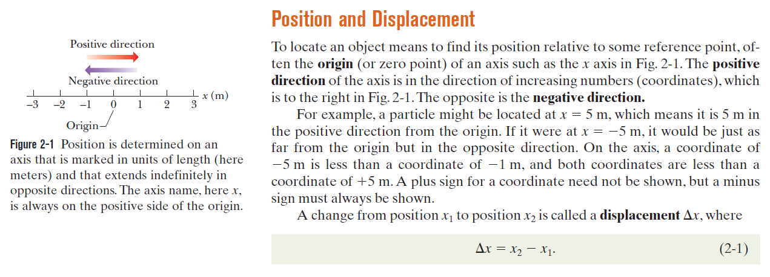

Slide 24
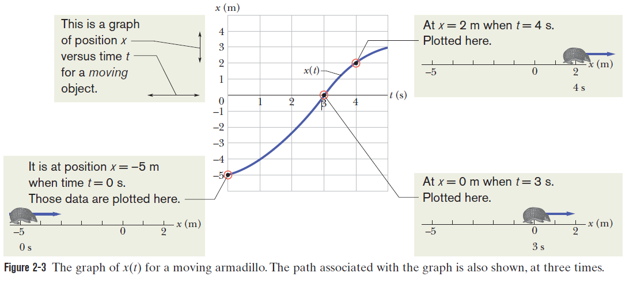
Average Velocity and Average Speed
Figure 2-3 is more interesting, because it involves motion. The armadillo is apparently first noticed at t =0 when it is at the position x=5 m. It moves toward x=0, passes through that point at t =3 s, and then moves on to increasingly larger positive values of x. Figure 2-3 also depicts the straight-line motion of the armadillo (at three times) and is something like what you would see. The graph in Fig. 2-3 is more abstract, but it reveals how fast the armadillo moves.

Slide 25
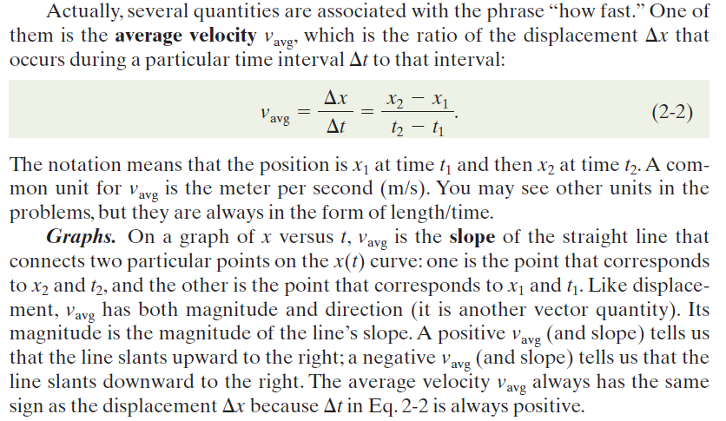

Slide 26
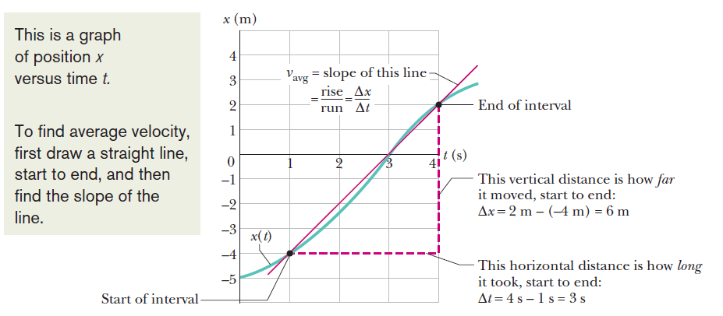

Slide 27
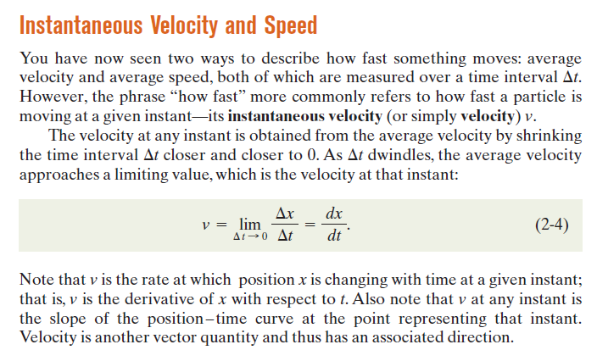

Slide 28
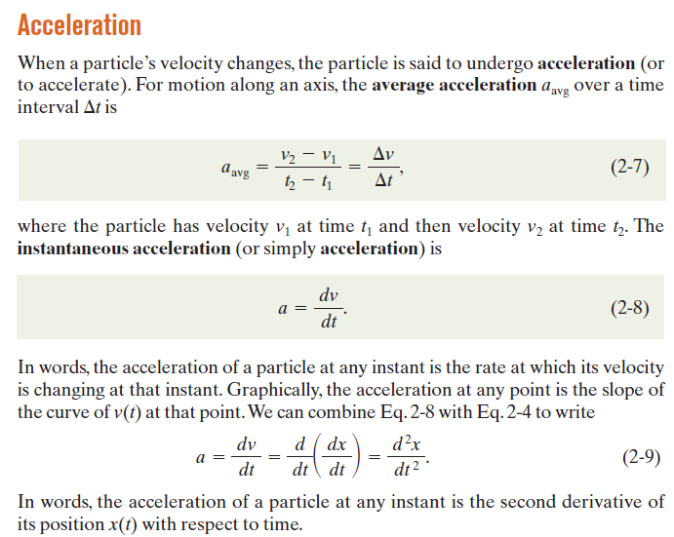

Slide 29
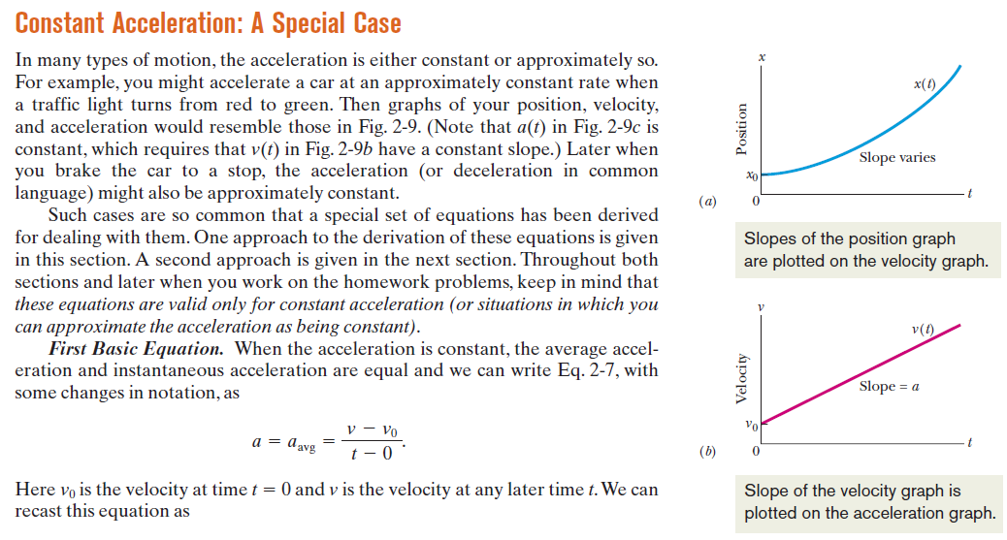

Slide 30
Torque, or moment is the tendency of a force to rotate an object around an axis
Momentum is the product of the mass and velocity of an object
Force is any interaction that will change the motion of an object. In other words, a force can cause an object with mass to change its velocity
Acceleration: a rate of increase of velocity
Deceleration: a rate of decrease in velocity

Slide 31
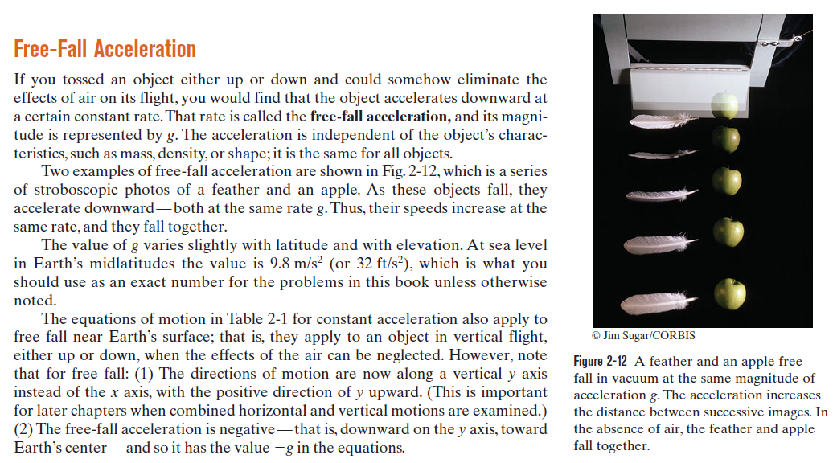

Slide 32
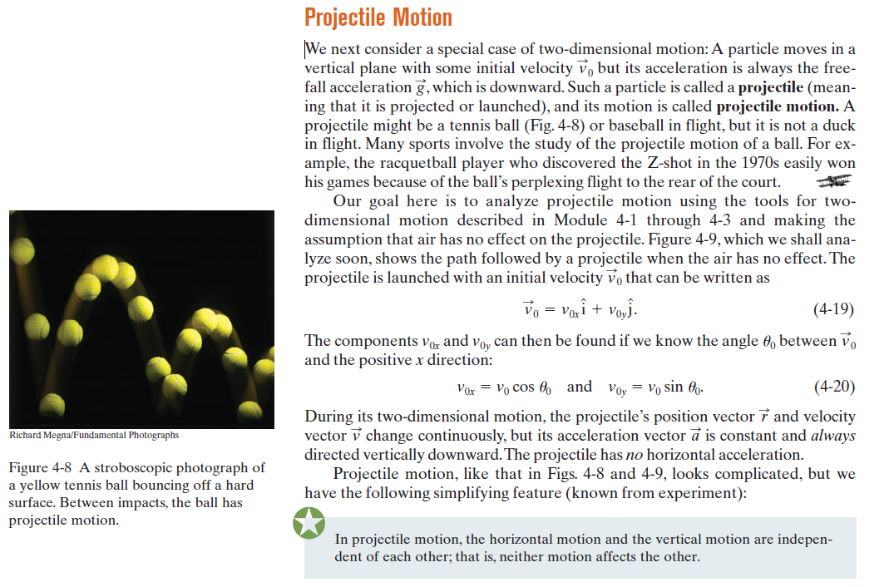

Slide 33
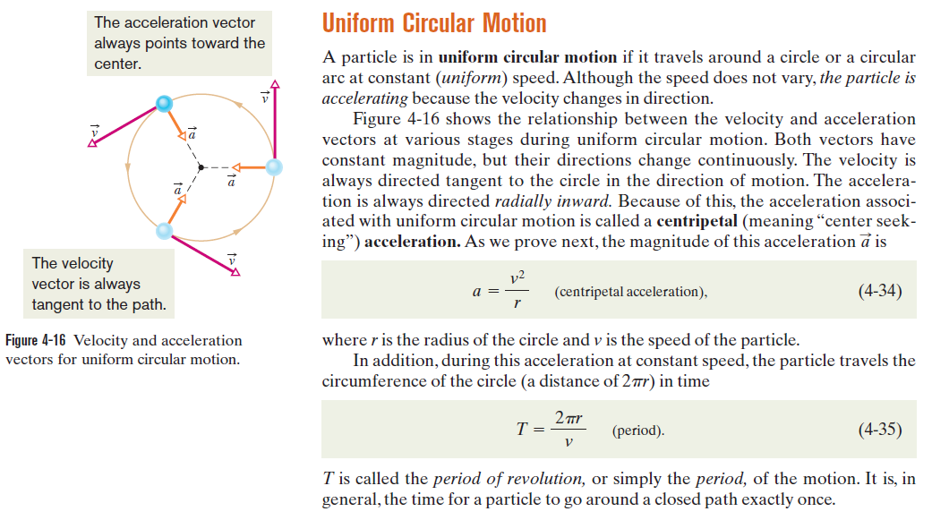

Slide 34
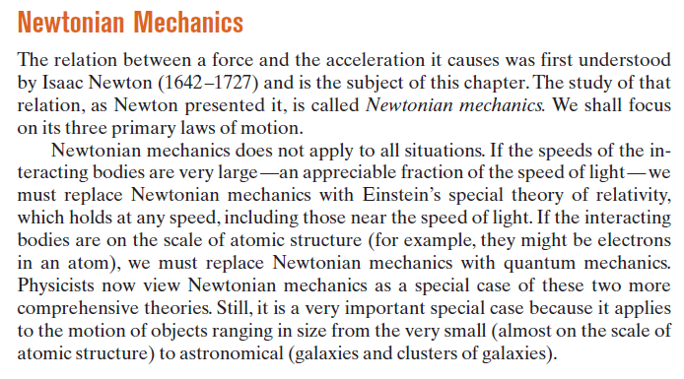

Slide 35
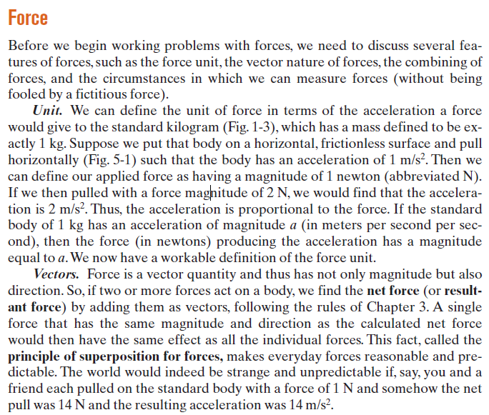

Slide 36
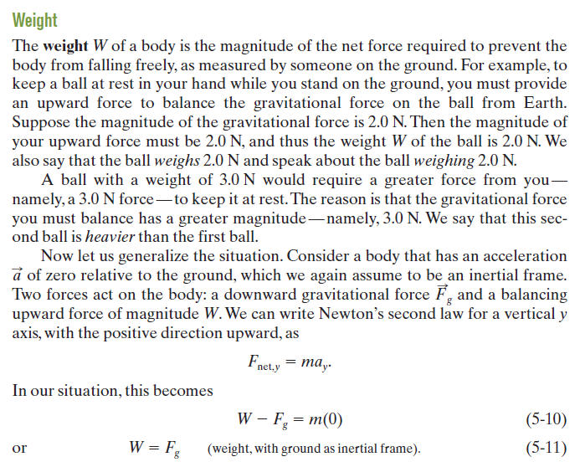

Slide 37
Energy is a property of objects which can be transferred to other objects or converted into different forms but never created or annihilated.
kinetic energy of an object is the energy that it possesses due to its motion.
Potential energy is energy possessed by a system of bodies due to their positions relative to each others
In physics, a force is said to do work if there is a displacement of the point of application in the direction of the force.
Heat is that amount of energy flowing from one body to another spontaneously due to their temperature difference, or by any means other than through work or the transfer of matter
Temperature is an objective comparative measurement of hot or cold.
Radiation is the emission or transmission of energy in the form of waves or particles through free space or through a material medium

Slide 38
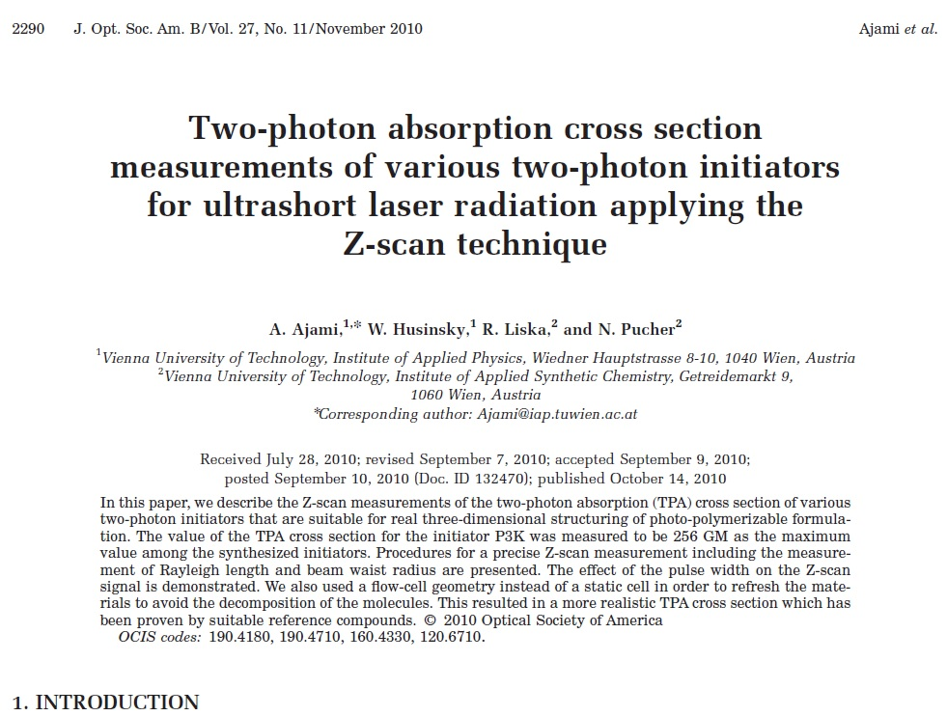
Title
First author
Author list
Affiliation
Abstract

Slide 39
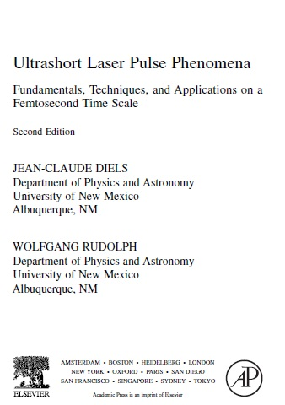
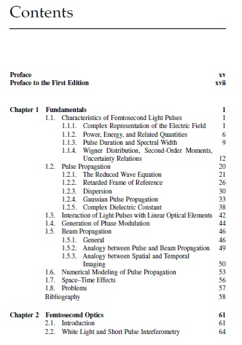

Slide 40
Vocabulary of the Unit 2; Electricity
Conductor: a substance that allows heat or electricity to pass through it.
Electric conductor, thermal conductor
Example: Metals are good conductors of electricity.
Approach: to move closer to someone or something.
Recede: to move back from a high point or level
Insulate: to cover something to prevent heat, cold, noise, or electricity from passing through it.
Insulate/Insulation/Insulator
Deduce: to know something as a result of considering the information
or evidence that you have.
Consequence: a result or effect of something

Slide 41
Arbitrary: not based on any particular plan or done for any particular reason.
Cavity: a hole or space inside a solid object.
Flux: the rate at which matter or energy flows across a surface or area.
Neutral: without electric charge.
Excess: a larger amount of something than is usual or necessary.
Deficiency: a fault in someone or something that makes them not good enough.
Deficient ≠ efficient
Perpendicular: completely upright and straight;
forming a 90° angle with another surface or line.
Equilibrium: a situation in which there is a balance
between different forces or aspects.
Component: one of the different parts that a machine
or piece of equipment consists of.
:

Slide 42
Assertion: a definite statement or claim that something is true.
Precise: exact and accurate.
Demonstration: an occasion when someone shows how something works
or how to do something; an action that shows how you feel.
Magnitude: size, either great or small.
Induce: to cause something, especially a mental or physical change.
Carry: take someone/something somewhere.
Transfer: move to somewhere else.
Shield: to protect something, usually from being hit, touched, or seen.
Influence: the effect that a person or thing has on someone's decisions,
opinions, or behavior or on the way something happens.

Slide 43
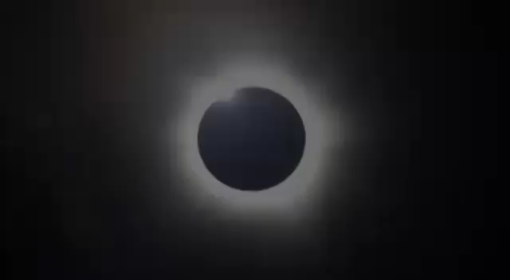

Slide 44
