Slide 1
Special topics
Taylor series (expansion)
Fourier Series
Fourier transformation
Gaussian Beam
Determining the Gaussian laser Beam characteristics
Periodic optical systems
Resonator stability
Nonlinear susceptibility
Kerr effect
Two-photon absorption
Second harmonic, sum and difference frequency generation
Third harmonic generation

Slide 2
Taylor series (expansion)
Taylor series is a representation of a function as an infinite sum of terms that are calculated from the values of the function's derivatives at a single point. If the Taylor series is centered at zero, then that series is also called a Maclaurin series.
is the nth order derivative of function
The derivative of order zero of f (x) is defined to be f (x)itself and (x − a)⁰ and 0! are both defined to be 1

Slide 3
Examples:
Calculate the Taylor expansion of at x = 0

Slide 5
Calculate the Taylor expansion of the following functions at x = 0

Slide 6
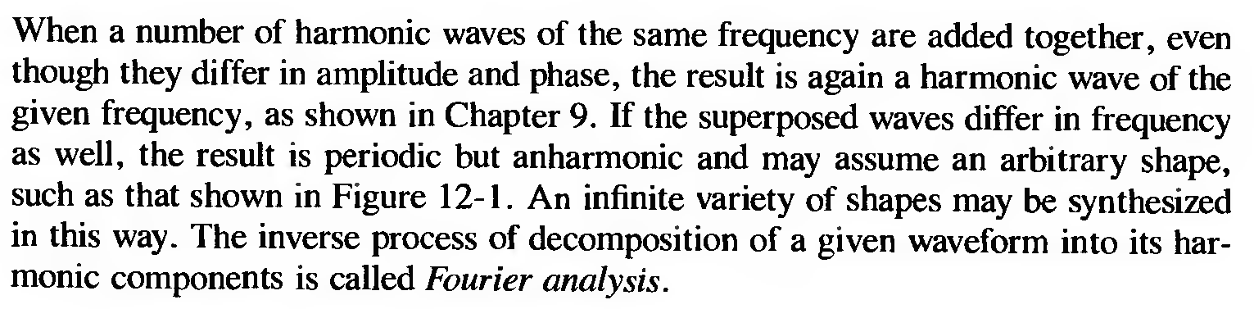
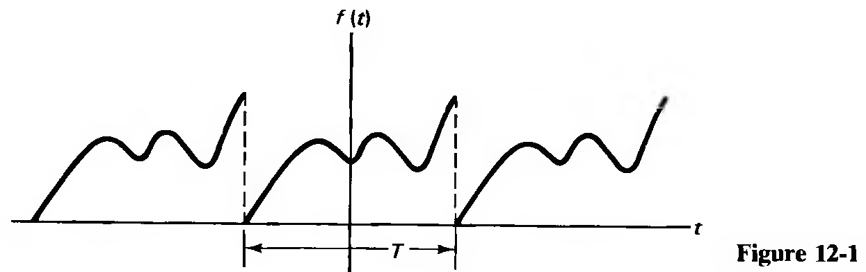
Fourier series
Fourier series is a periodic function composed of harmonically related sinusoids, combined by a weighted summation

Slide 7
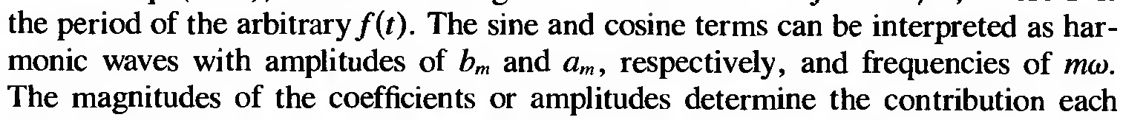
(1)
If Eq. (1) is multiplied by dt and integrated over one period T, the sine and cosine integrals vanish, and the result is

Slide 8
If Eq. (1) is multiplied throughout instead by Cos(nωt) dt, where n is any integer, and then integrated over a period, the only nonvanishing integral on the right side is the one including the coefficient a_{m} and one finds
(3)
Similarly, multiplying Eq. (1) by Sin(nωt) dt and integrating gives
(4)

Slide 9

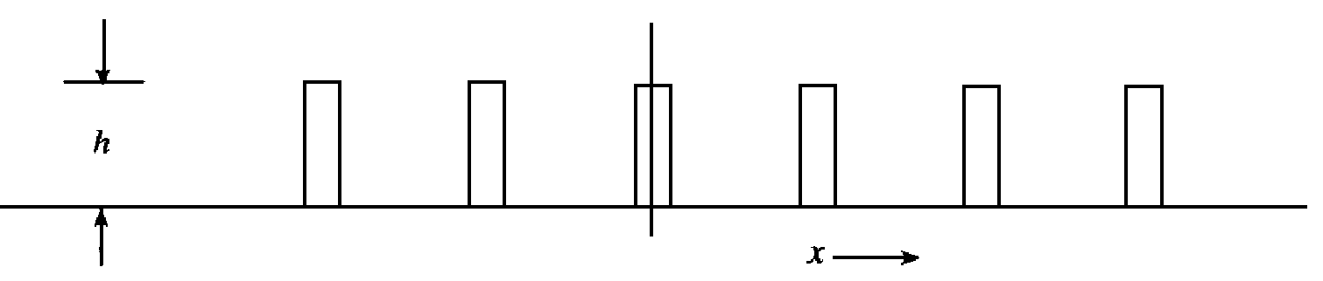
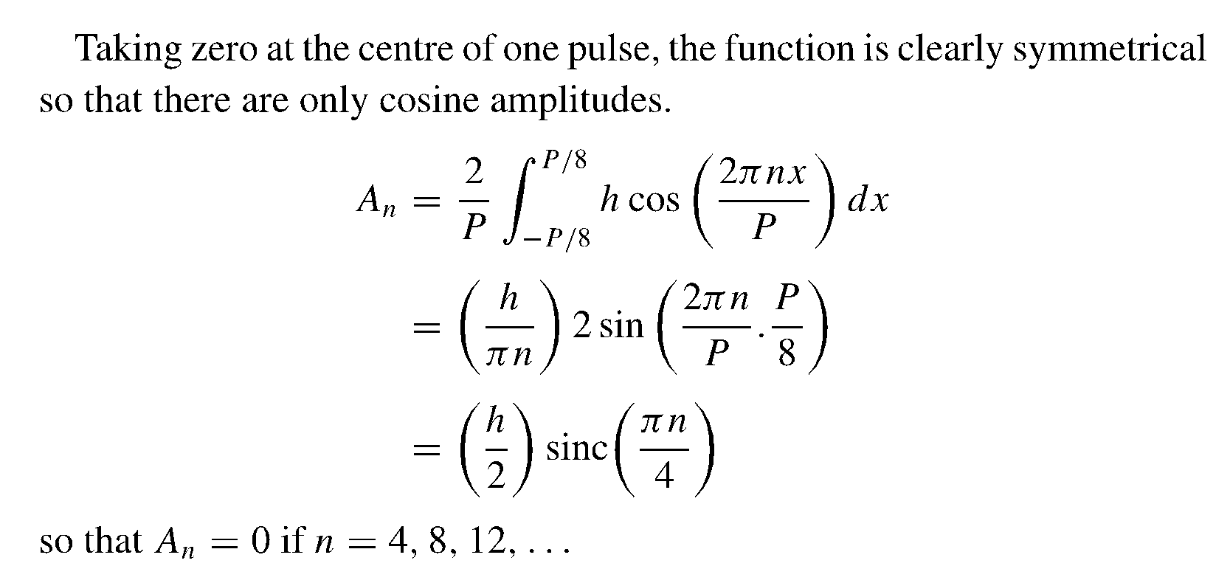
Example:
P
P
W

Slide 10
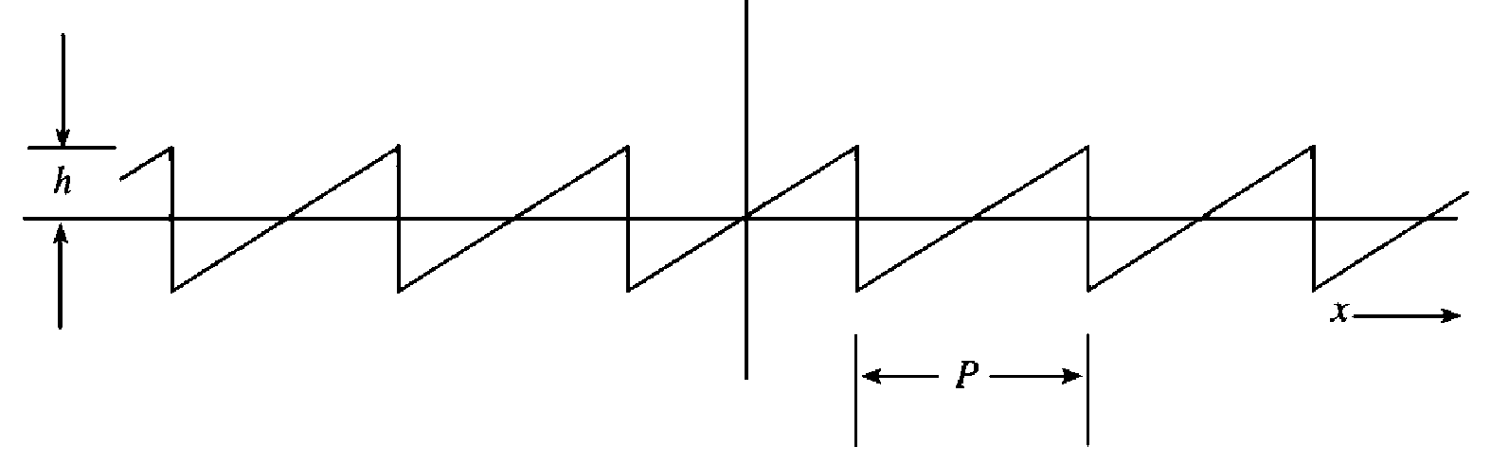
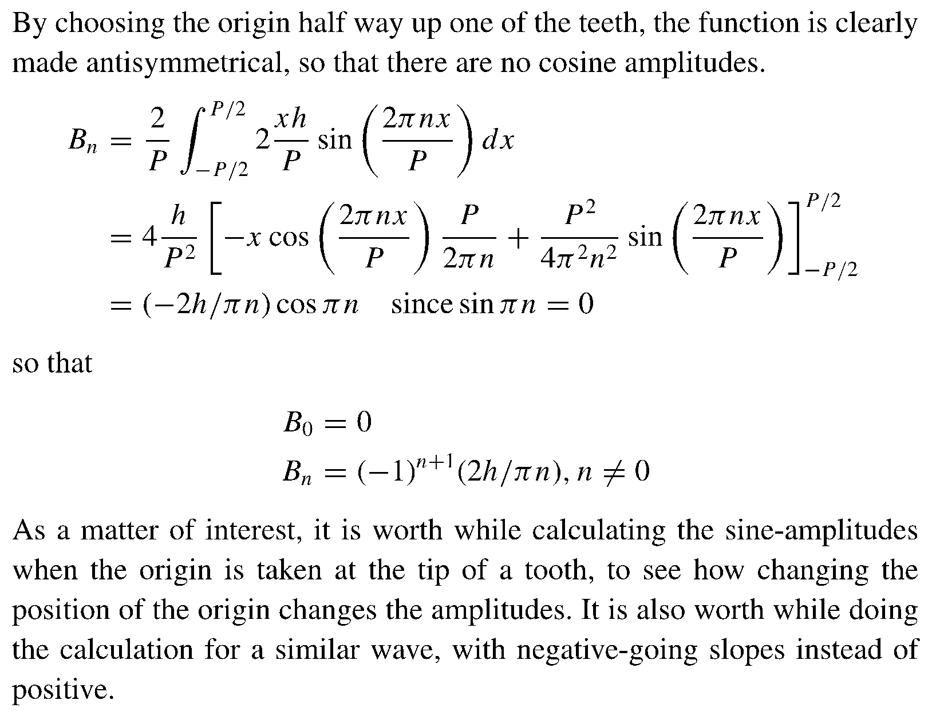

Slide 11
سري فوريه تابع دندان اره اي شكل زير را پيدا كنيد.
مبدا زمان روي شكل مشخص شد است.
t=0

Slide 12
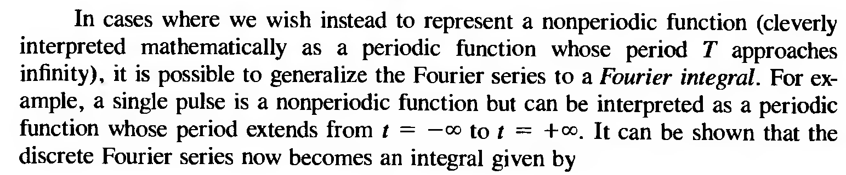
With the help of Euler's equation, the Fourier series given in general by Eq. (1), involving as it does both sine and cosine terms, can be expressed in complex notation using exponential functions. The result is
(5)
(6)

Slide 13
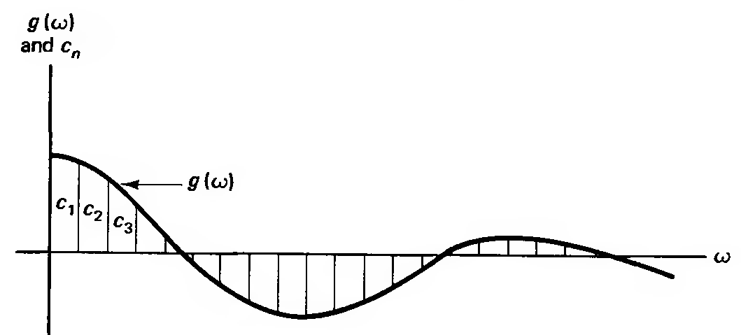
(7)
(8)
In Figure below, a sample discrete set of coefficients, as might be calculated from Eq. (6), is shown together with a continuous distribution approximated by the coefficients, such as might result from Eq. (8).

Slide 14
It should be pointed out that if the function to be represented is a function of spatial position x with period L, say, rather than of time t with period T, then in Eqs. (1) through (8) T should be replaced by L and the temporal frequency should be replaced by the spatial frequency, . For example, the Fourier transforms in Eqs. (7) and (8) become :
(9)
(10)

Slide 15
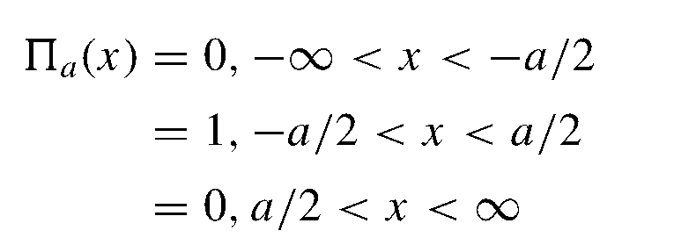

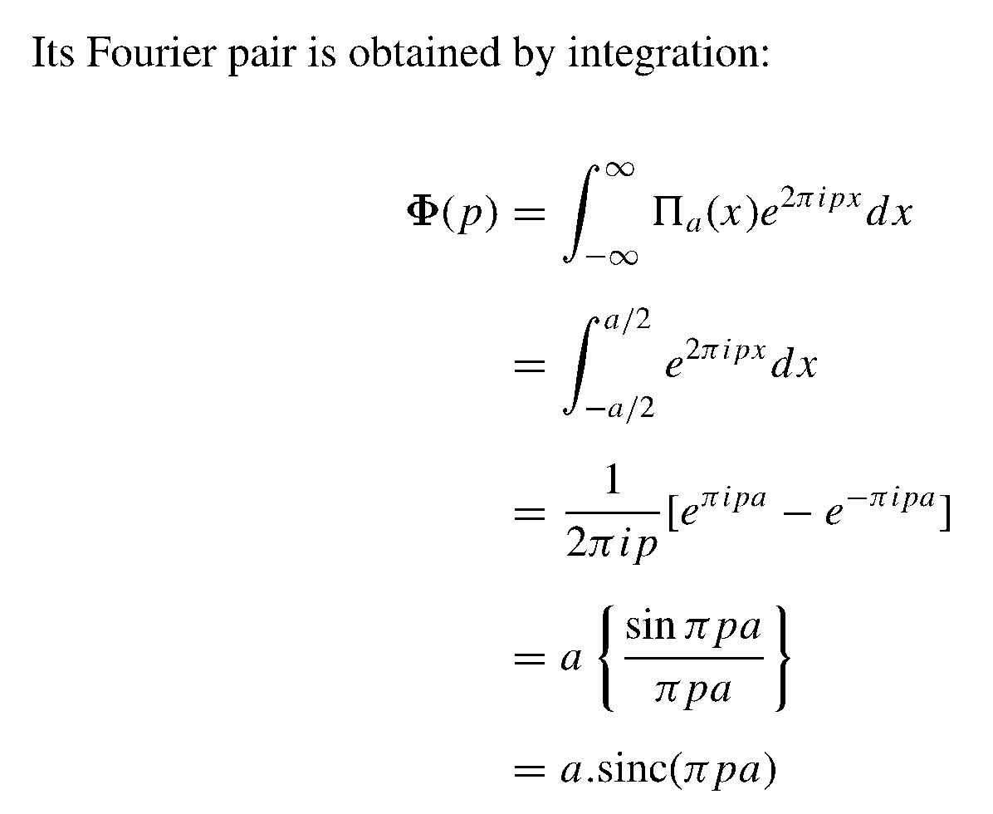
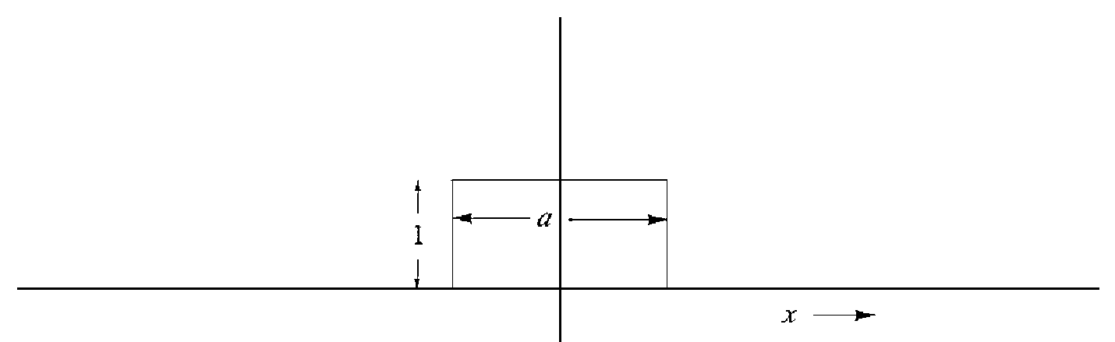

Slide 16
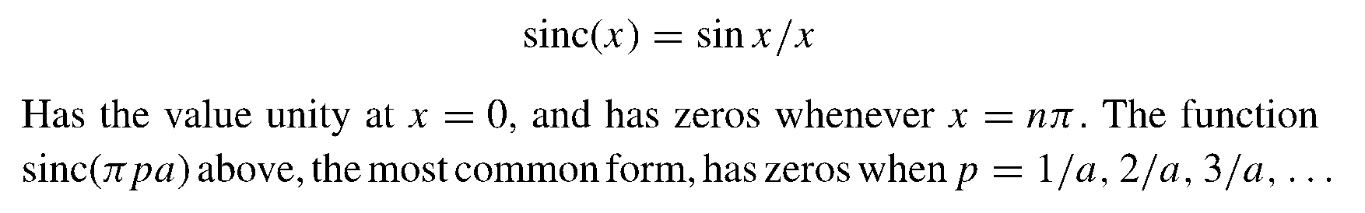
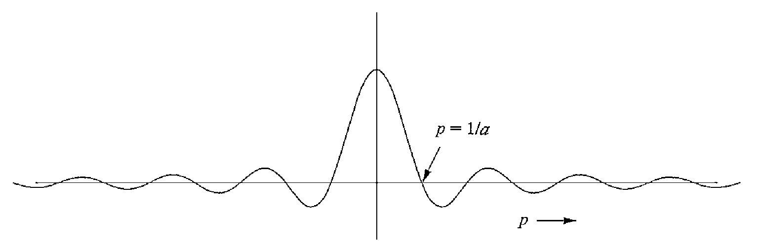

Slide 17

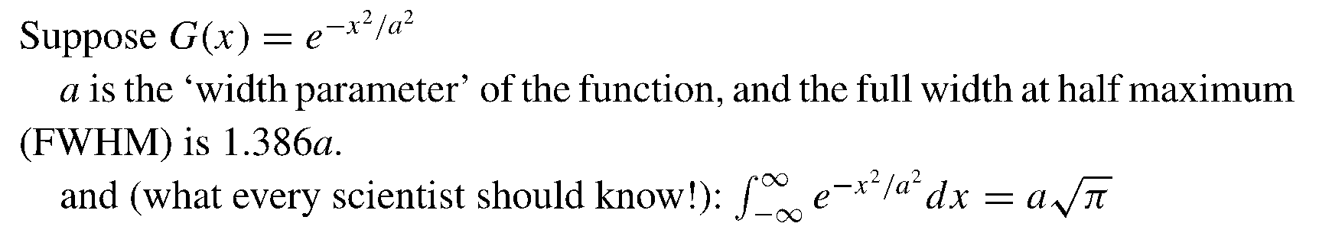
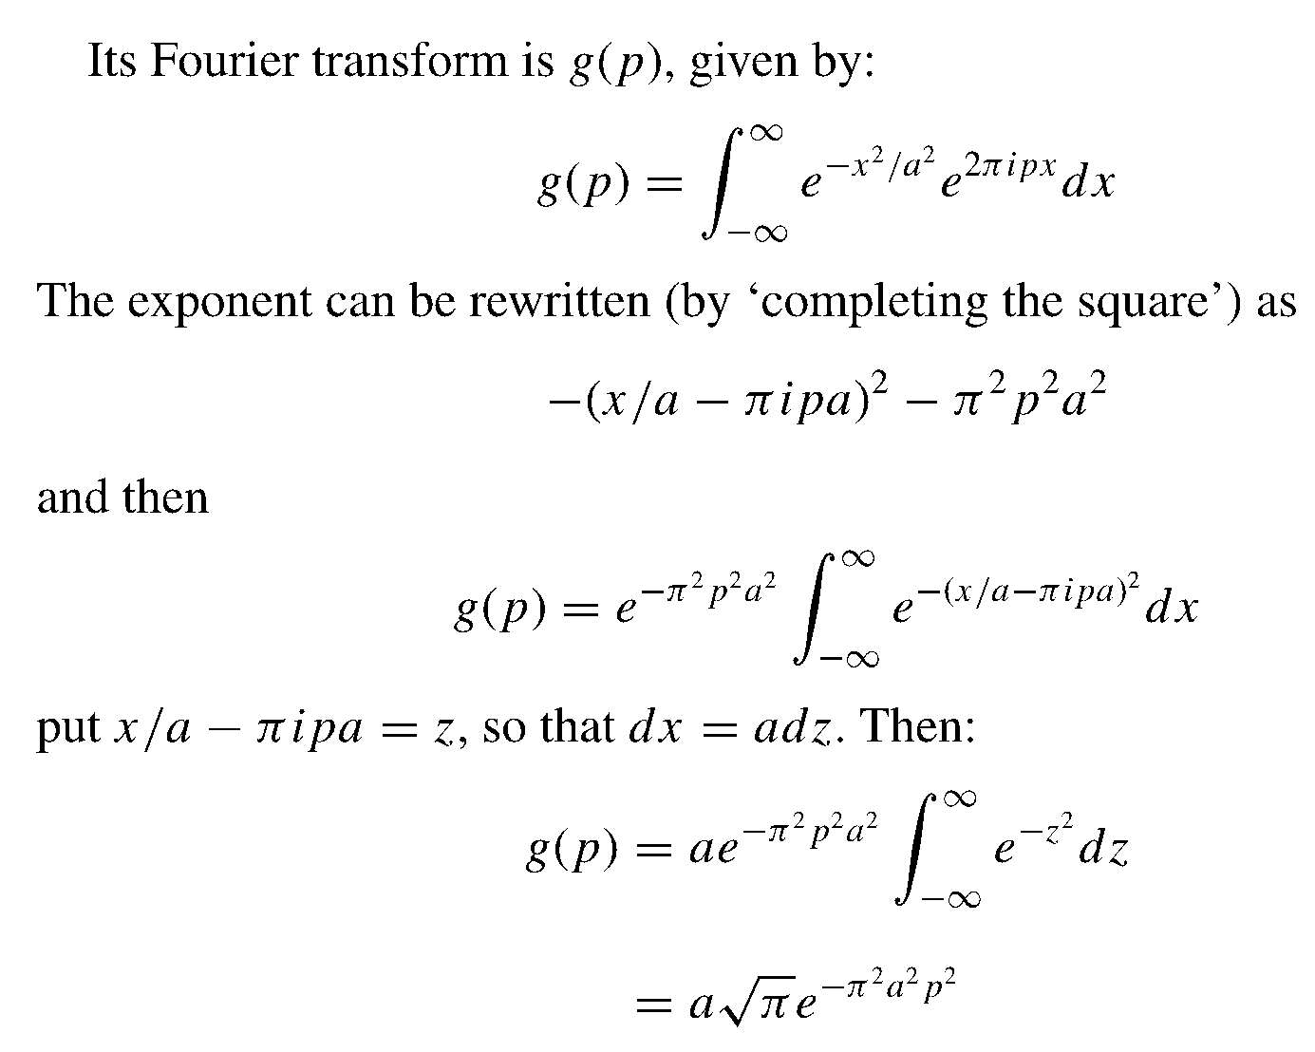

Slide 18
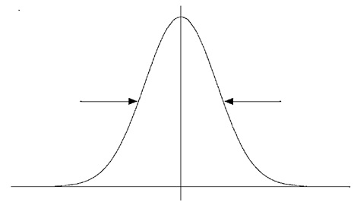
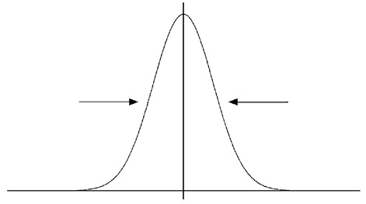
FWHM
x
k, p

Slide 19
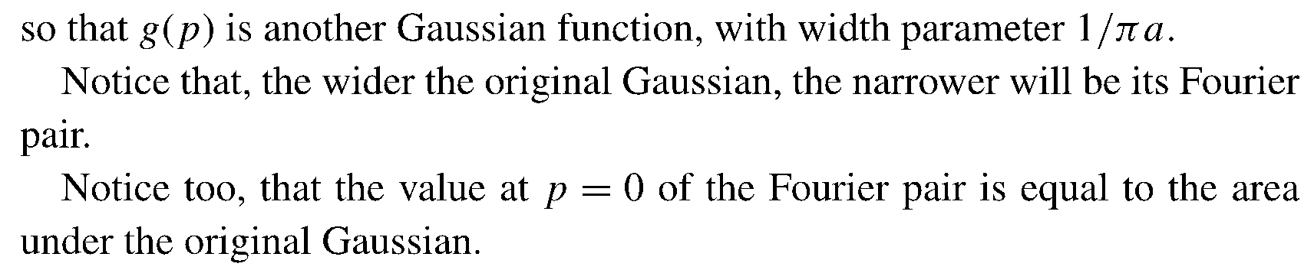

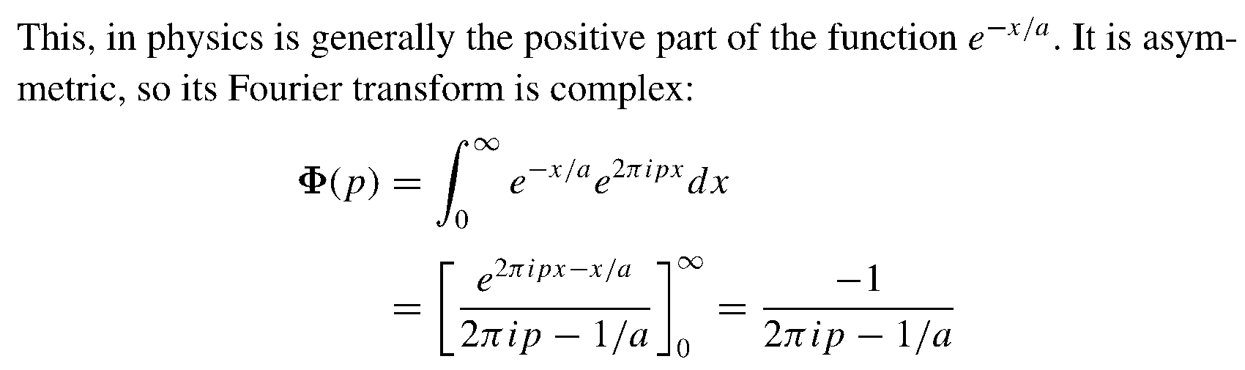

Slide 20
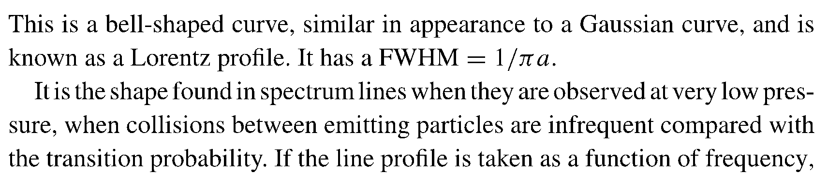
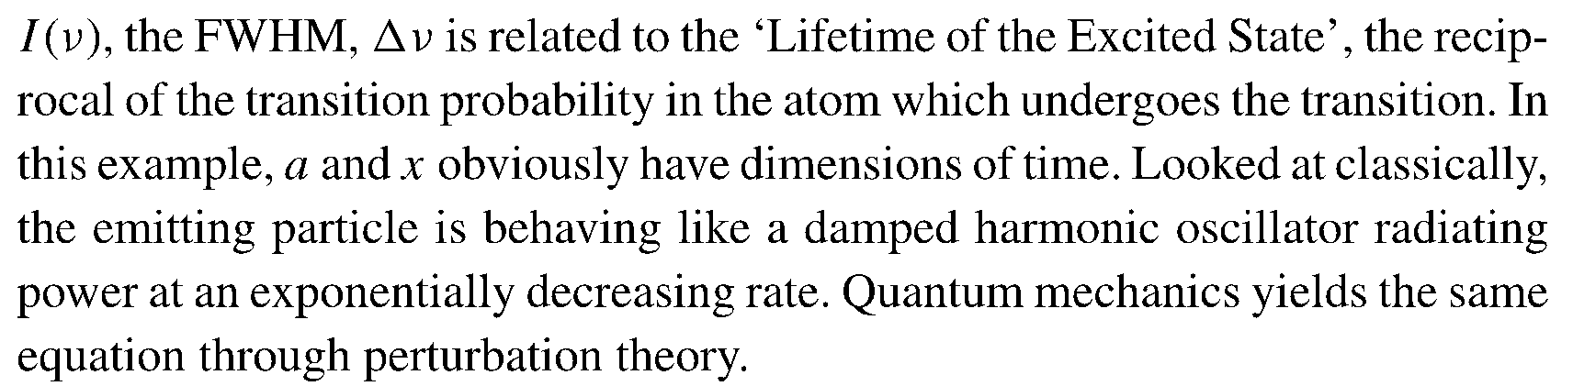
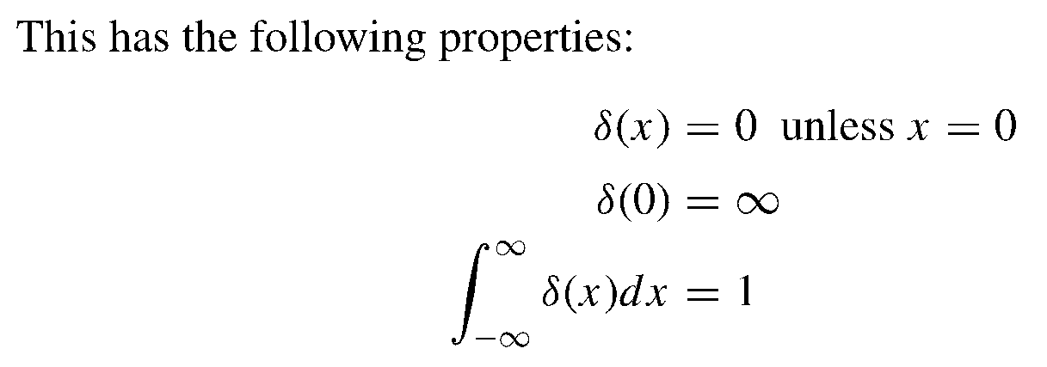


Slide 21
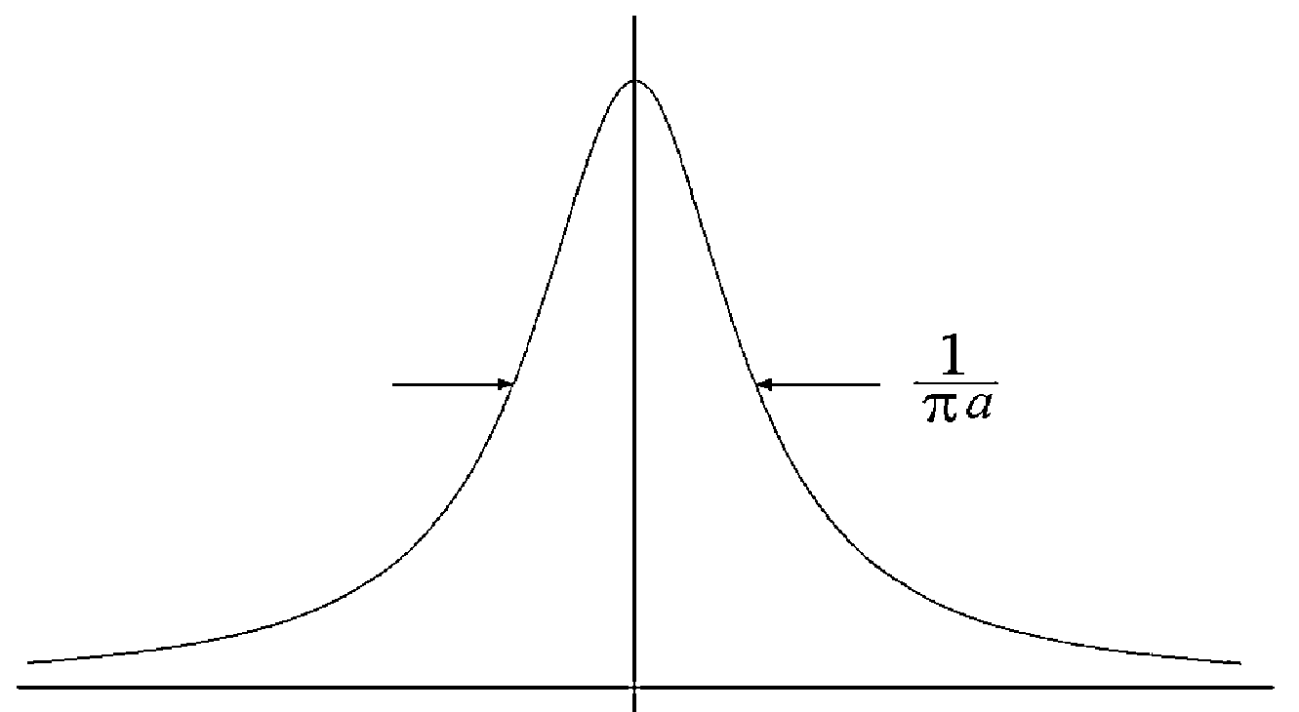
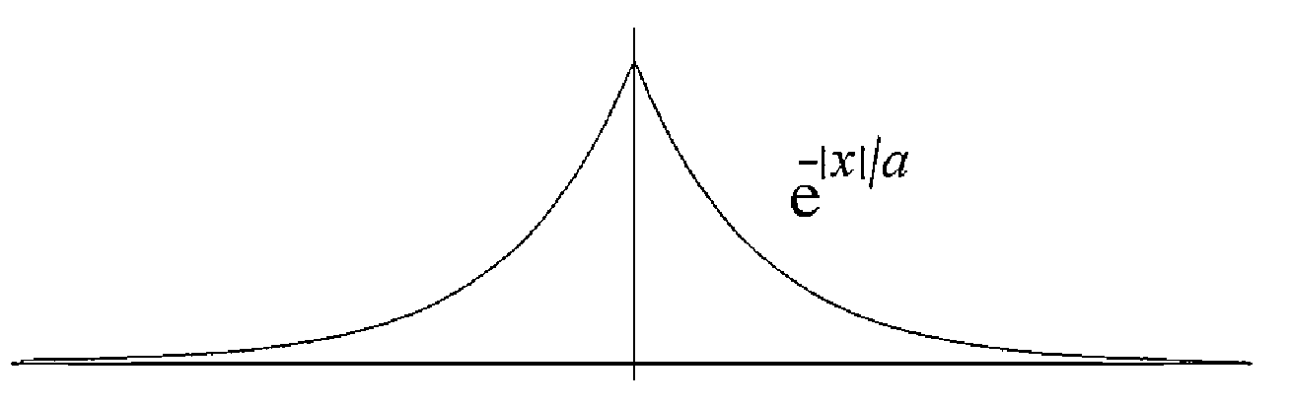
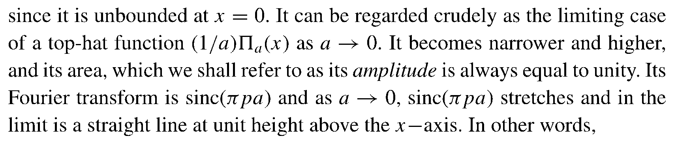
When a becomes smaller the width of the exponential decay becomes narrower. Therefore, the Dirac delta function can be regarded as the exponential decay function as its width a goes toward zero.

Slide 22
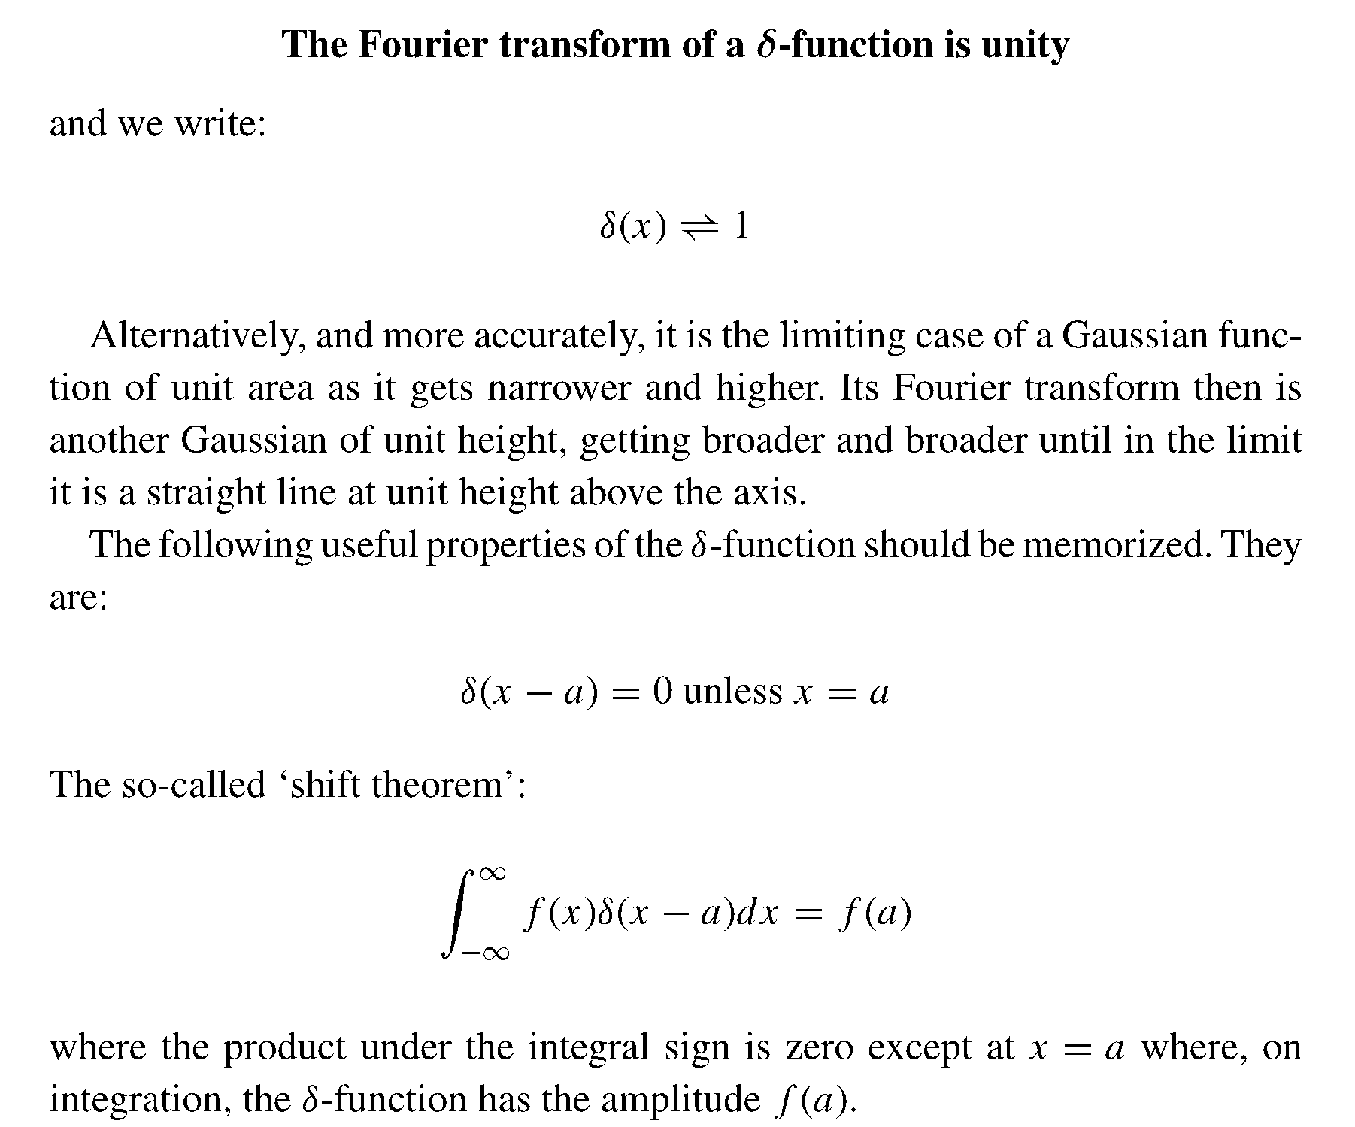

Slide 23
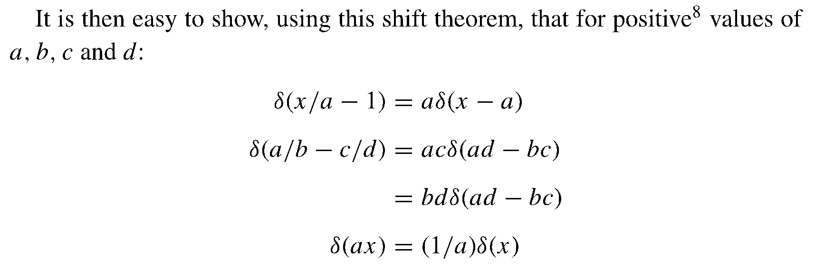
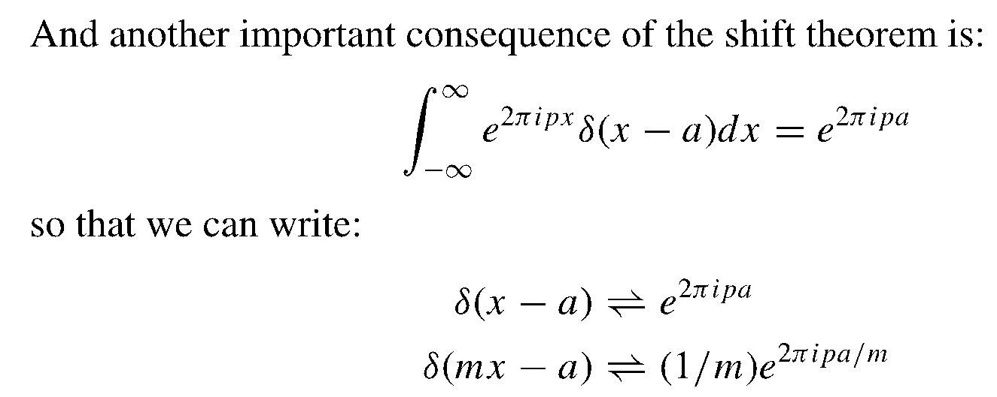

Slide 24
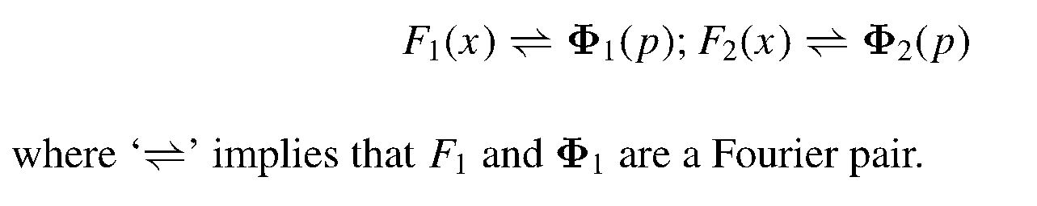

Slide 25
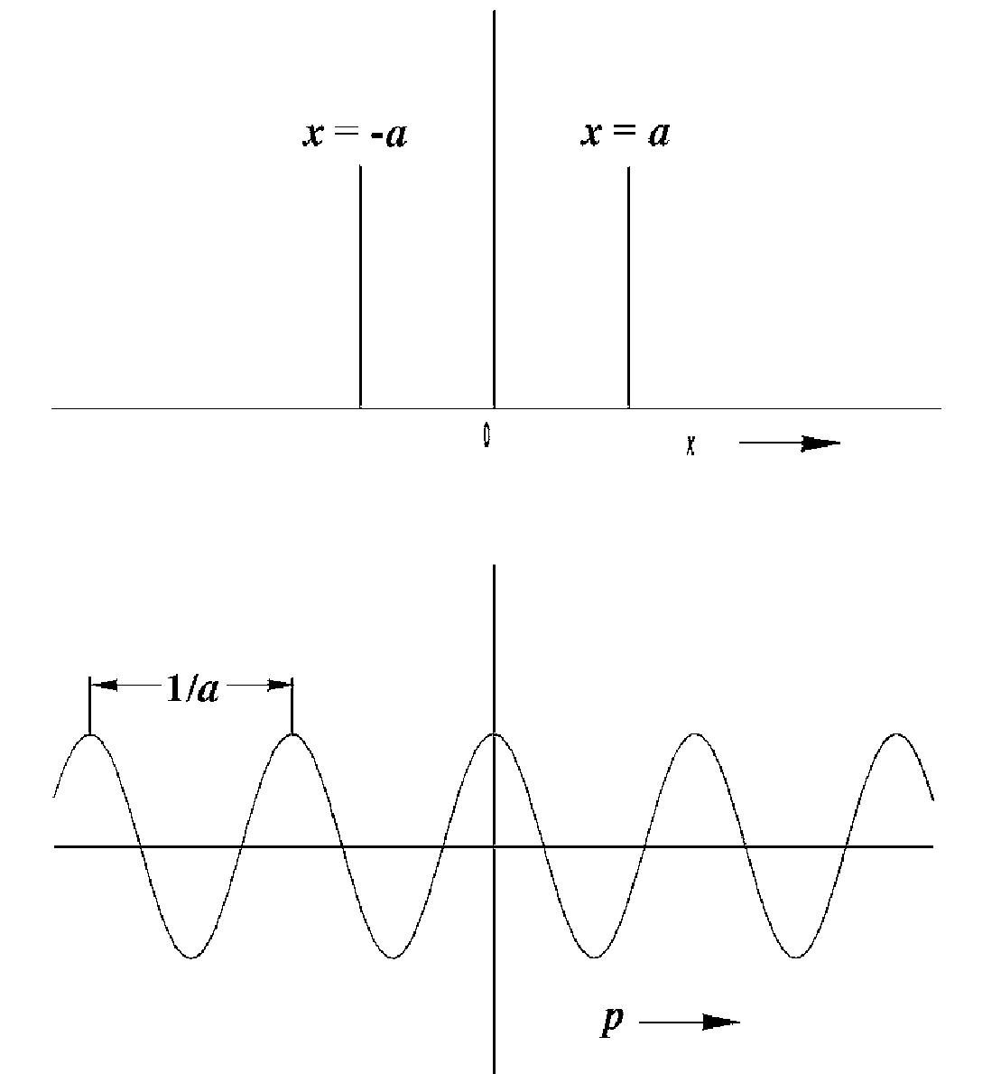

Slide 26
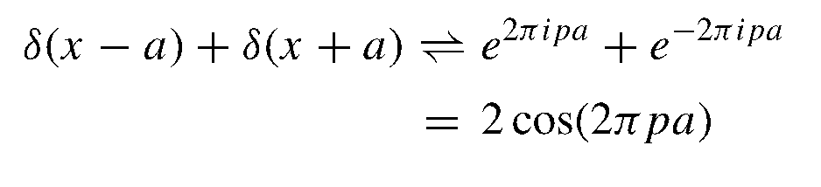

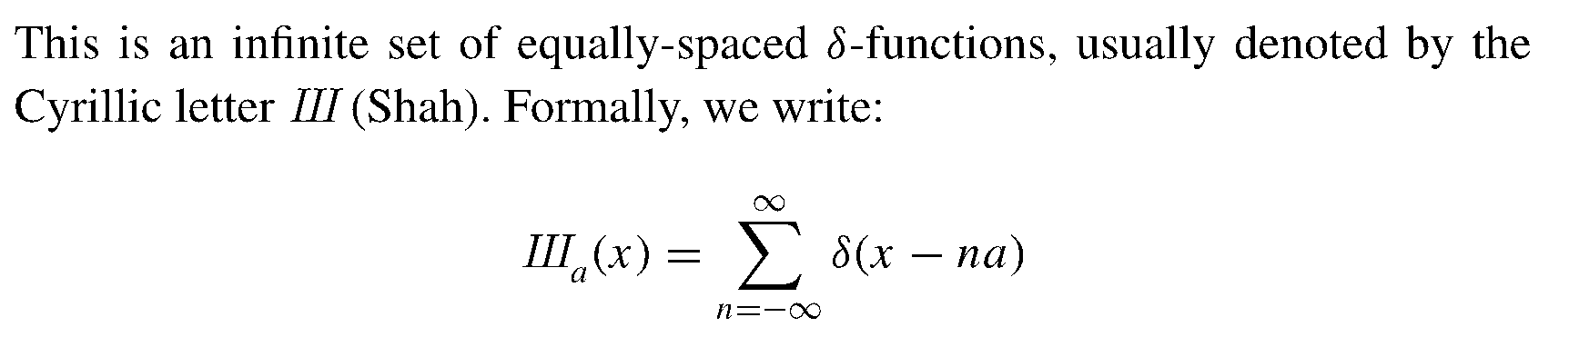

Slide 27
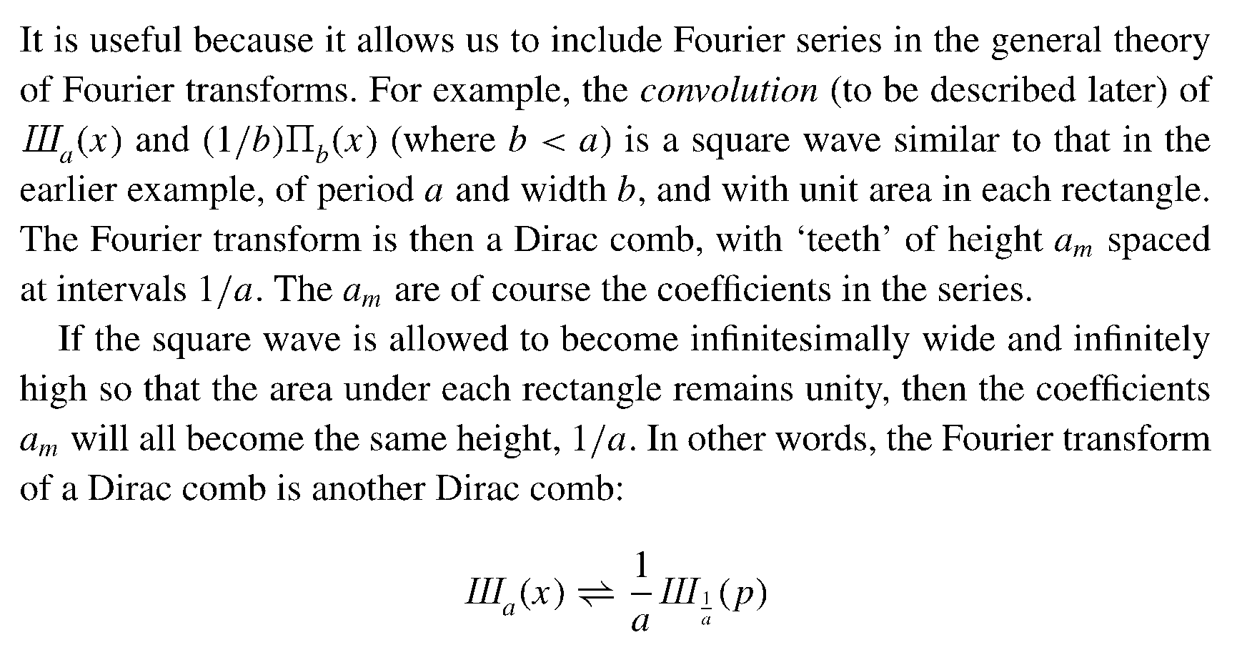
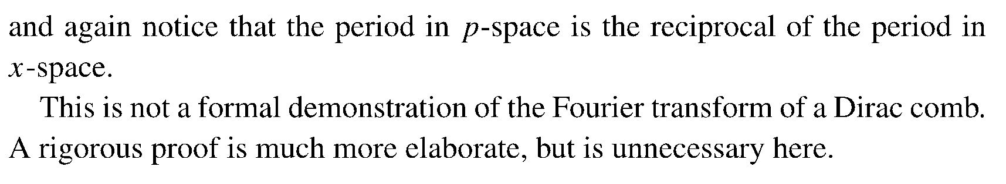

Slide 28
The spectral resolution of an infinitely long sinusoidal wave is extremely simple: It is one term of the Fourier series, the term corresponding to the actual frequency of the wave. In this case, all other coefficients vanish. Sinusoidal waves without a beginning or an end are, however, mathematical idealizations. In practice, the wave is turned on and off at finite times. The result is a wave train of finite length. Fourier analysis of such a wave train must regard it as a nonperiodic function. Clearly, it cannot be represented by a single sine wave that has no beginning or end. Rather, the various harmonic waves that combine to produce the wave train must be numerous and so selected that they produce exactly the wave train during the time interval it exists and cancel exactly everywhere outside that interval. Evidently, the turning "on" and "off" of the wave adds many other spectral components to that of the temporary wave train itself. The use of the Fourier-transform integrals leads, in fact, to a continuous distribution of frequency components. What we have said here of a finite wave train is also true of any isolated pulse, regardless of its shape. We consider for simplicity the spectral resolution of a pulse that is, while it exists at some point, a harmonic wave. We have placed the origin of the time frame so that the wave train is symmetrical about it. The wave train has a lifetime of τ₀ and a frequency of ω₀. Thus it may be represented by

Slide 29
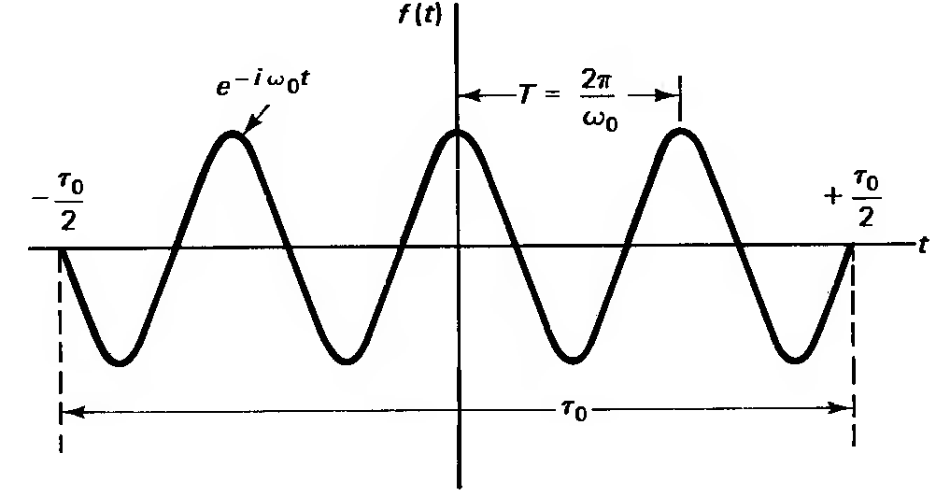
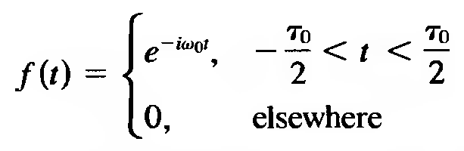
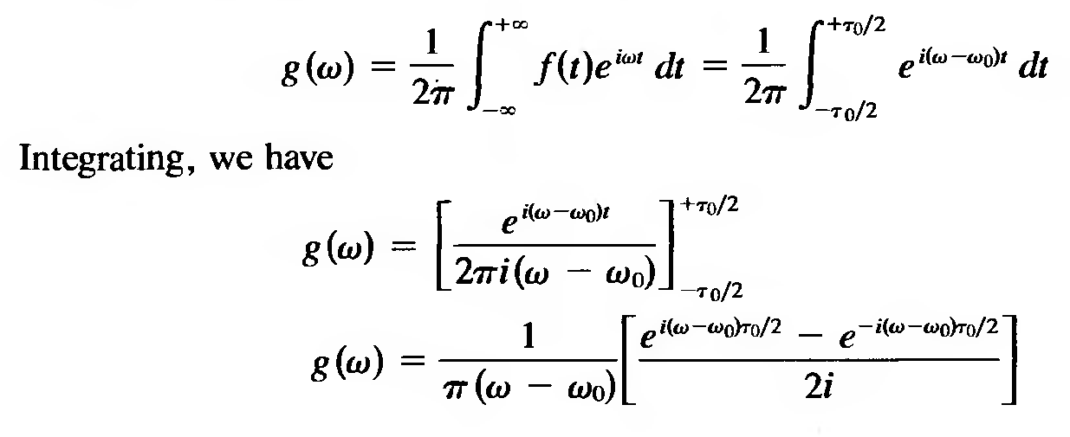

Slide 30




Slide 31
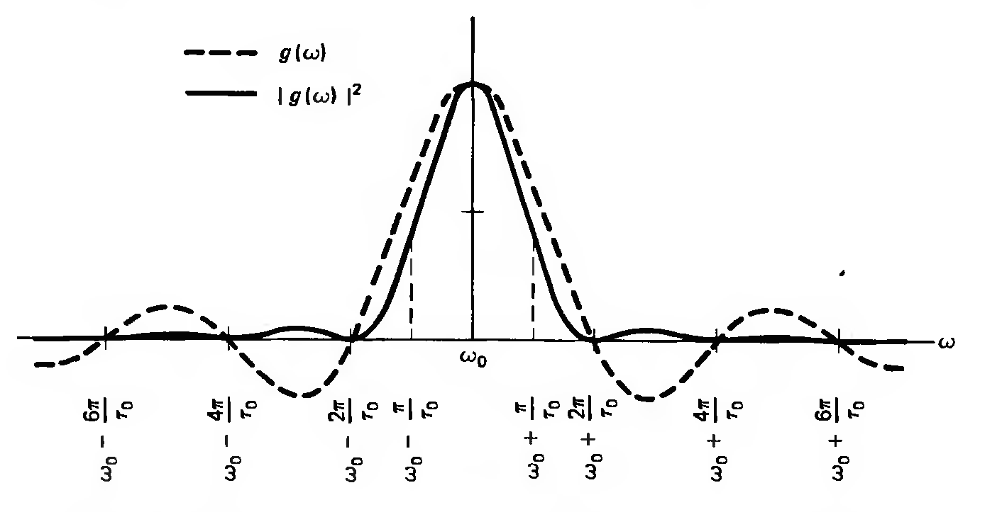
Thus the sharper or narrower the pulse, the greater is the number of frequencies required to represent it, and so the greater the line width, or ∆λ, of the harmonic wave package.

Slide 32
Gaussian Beam
A real laser beam has a unique direction and finite width. A plane wave or a spherical wave both can not be a real laser beam because a plane wave although has a unique direction but does not have finite width and it spreads all over the space. A spherical wave has a finite width but has not a unique direction and it propagates in all directions. Thus, the wave equation has to be solved with paraxial approximation to derive the Gaussian wave representing a finite width light beam propagating in a certain direction.
When the radiation propagates through the free space (where the polarization is zero) the wave equation is given by:

Slide 33
An spherical monochromatic wave can be the solution for the wave equation
where r is the radial coordinate as the distance between the origin and the observation point.
Using paraxial approximation in which a small patch of observation plane around z-axis is considered, the radial coordinate r can be approximated as follows

Slide 34
Now the spatial part of solution is modified as
. It can be easily shown that if the real parameter z is replaced by the complex parameter z+iz₀, E(r) is still a solution for Helmholtz equation but it attains additional remarkable properties. Thus

Slide 36
the wave front curvature of radius
the beam radius
beam waist radius
the Rayleigh range (length)
the propagation phase variation

Slide 37
the Rayleigh range that refers to a distance from the beam waist where the beam radius grows by a factor of √2 compared to beam waist radius therefore, the spot area increases by a factor of 2 compared to the beam spot at the beam waist.
E can be representative for a light beam because it has a finite extent that depends on coordinate x, y and z and also it has a unidirectional propagation in the positive z direction.
Since the radial distribution of the electric field and subsequently the intensity pattern obeys a Gaussian function, this traveling electric field represents the electric field of a Gaussian light beam.

Slide 38
The light intensity is always proportional to the square of the modulus of the electric field thus the spatial intensity distribution of a Gaussian beam is characterized by the Gaussian function as follow:
The light power is obtained by integration the intensity over r in the plane normal to the propagation direction of the incident beam. So

Slide 39
The average intensity over the entire laser spot equals to half of the maximum intensity at the center of spot.

Slide 40
The power transferred through an aperture of radius a can also be calculated by integration of the intensity over r from the origin up to a distance a.
The aperture transmittance defined as the quotient of the power transmitted through the aperture and the entire incident power can be written as:
where a is the aperture radius, w(z) is the beam radius in the aperture plane and z is the aperture position.

Slide 41
Blue line presents the distribution in z direction and the Red line for r direction
For case of tight focus where the beam waist radius is very small
For case of wide focus where the beam waist radius is large

Slide 42
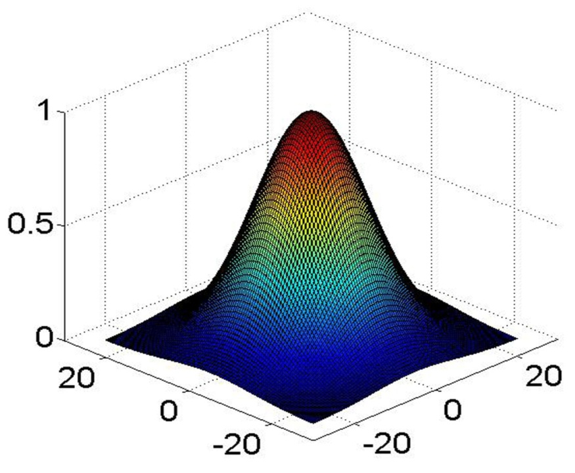
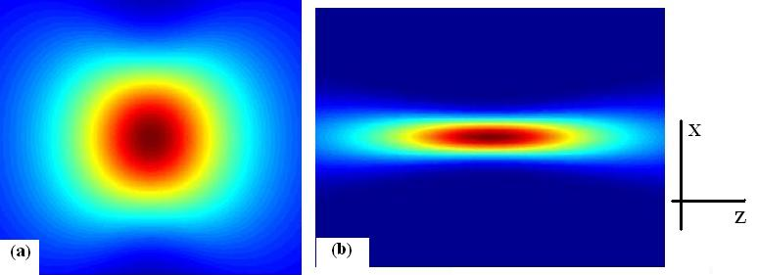
Intensity distribution of a Gaussian beam in the xz plane. Figure (a) represents a spherical Voxel for a beam waist diameter of 330 nm. Figure (b) demonstrates an elliptical Voxel when the beam diameter at the beam waist diameter is 2 Micron (scale is not the same for these two figures).
The 2D intensity distribution of a Gaussian beam plotted versus the distance from the optical axis.

Slide 43
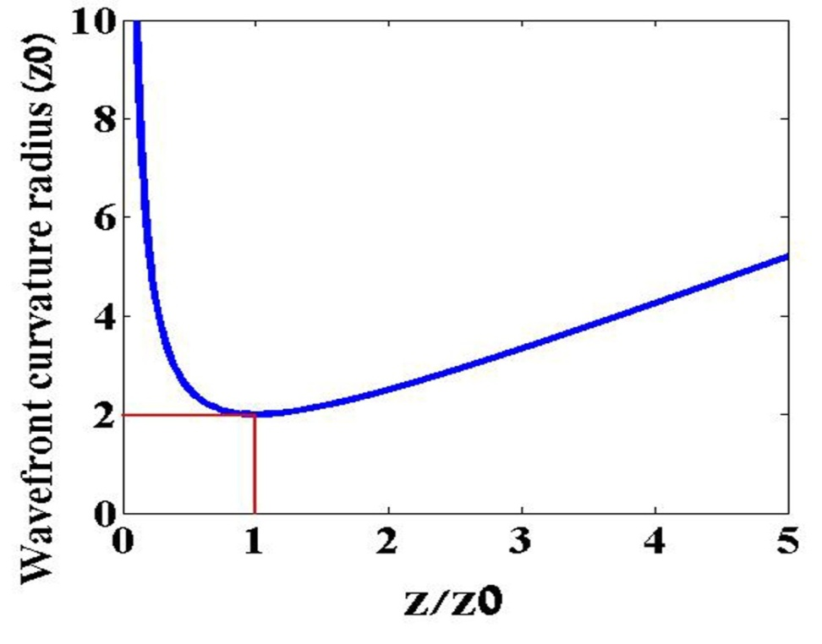
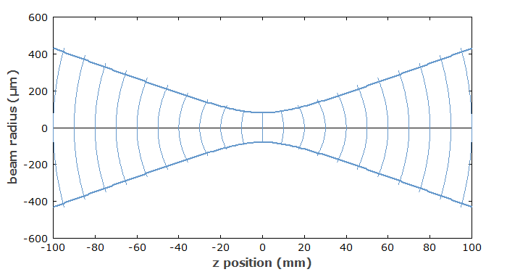
At the origin (z=0) the wavefront curvature radius of the light beam R(z) is infinite representing a plane wave. The radius of the wavefront curvature reaches its minimum value of 2z₀ at the position z = z₀. 2z₀ is known as the confocal range in analogy with the distance between two mirrors in a laser resonator with confocal configuration. In the confocal configuration the focal points of two identical mirrors are coincident allowing each mirror located at the central point of another mirror that corresponds to a distance of 2f (f is the focal length of mirrors) between two mirrors which is equal to the curvature radius of the mirrors.

Slide 44
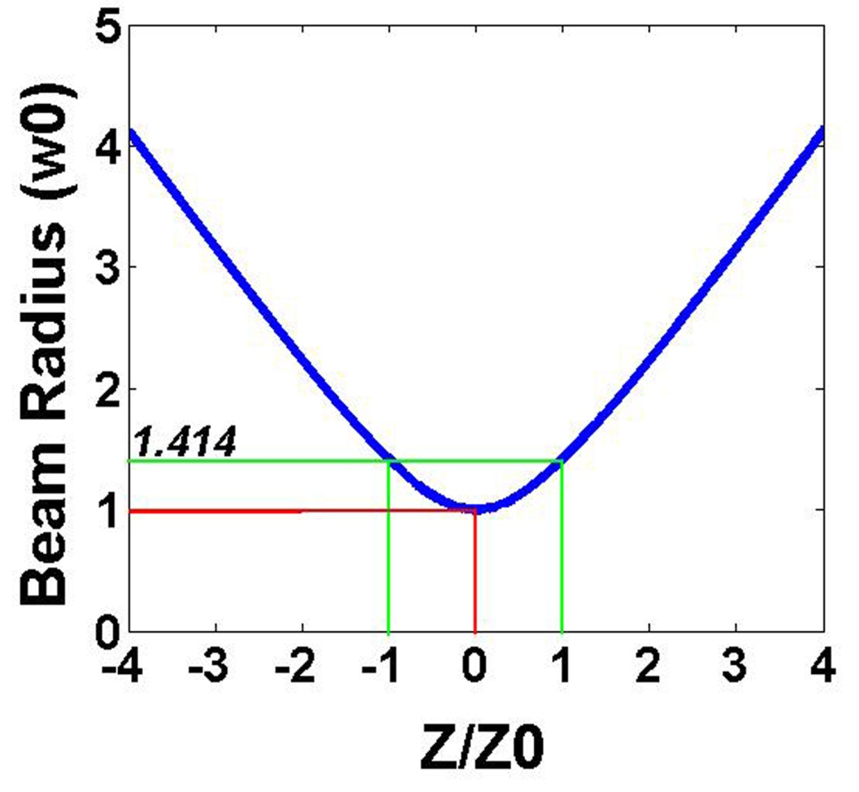
The beam radius plotted versus the distance from the focal plane as the scale of Rayleigh range.
The Rayleigh range is defined as the distance from the beam waist where the beam radius increases by a factor of √2 or correspondingly the intensity decreases by a factor of 2.

Slide 45
Waist of the beam
Beam divergence
θ

Slide 46
Beam divergence
1- half angle
2- full angle: is twice the half angle:
This angle is defined as the slop of the tangent line to the beam edge far enough from the beam waist
D: the beam waist diameter

Slide 47
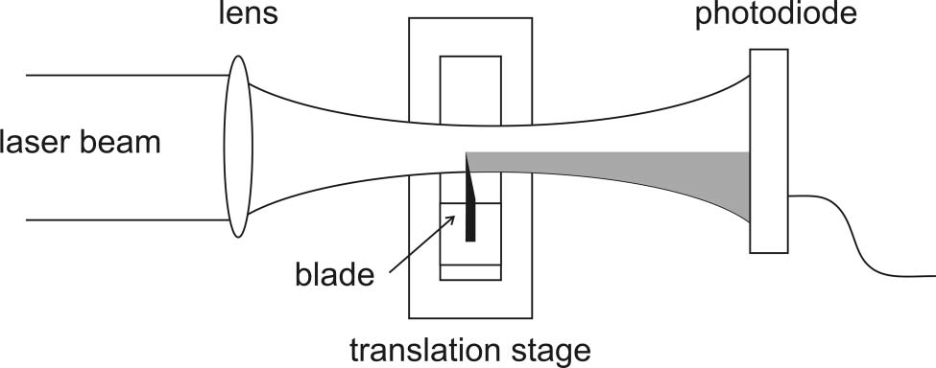
Measurement of Gaussian laser beam radius
using the knife-edge technique

Slide 48
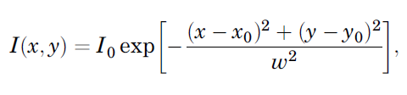
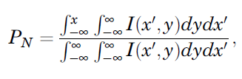
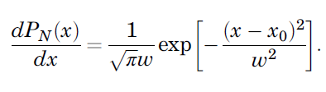
The area of the photodiode is considered to be larger than the area of the laser beam cross section at the detection position; therefore, diffraction effects may be neglected.

Slide 49
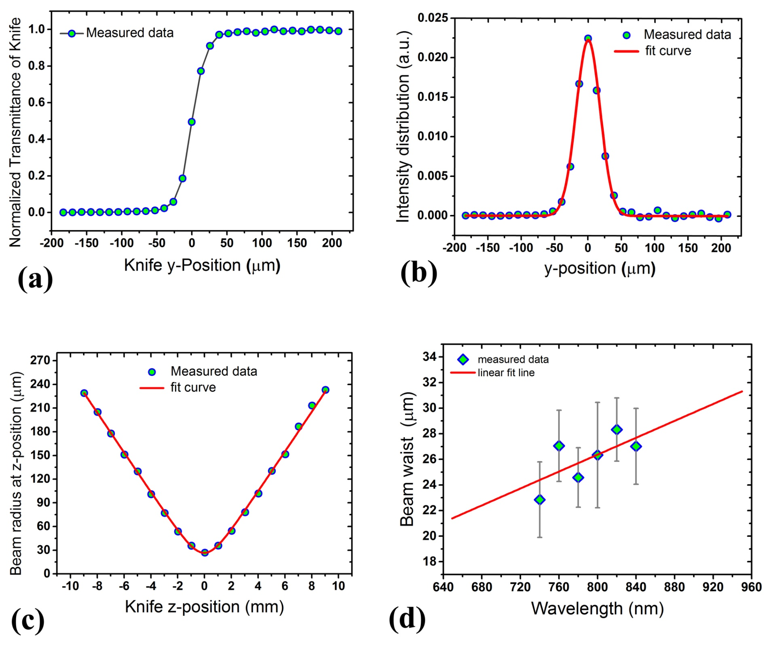

Slide 50
Resonator stability
In a resonator the light rays propagate back and forth therefore, a resonator is a periodic optical system.
If the ray transformation matrix of the repeatable element is given by the following:
Then the output parameters after n repeated optical elements can be derived as:

Slide 51
(6)

Slide 52
The determination of the ray transfer matrix is equal to unity:

Slide 53
In order to solve the Eq. (12) we can assume that:

Slide 54

1
$$\sqrt{1−b^{2} }$$
Ф
b
The beam position, y, would oscillate and comes back to its previous position if Ф is real.

Slide 55
For the case of real Φ the position of beam is a harmonic function of m. that means, in the periodic optical system the characteristics of beam (y and α) will become the same after passing through s similar repeatable optical element. Mathematically that means:

Slide 56
Example:
A set of similar lenses arranging in a line with equal distance
Lens
d
d
d
d
d
In this periodic optical system, the light beam travels through free space with length of d and then refracted by a lens. Thus, the repeated optical element consist of two elements: propagating in free space and refraction by a thin lens. Therefore, the ray transfer matrix of the repeated optical system can be written as:

Slide 57
It can be assumed that the light is first refracted by a thin lens and then travels through free space with length of d. Thus, the repeated optical element consist of two elements: refraction by a thin lens and propagating in free space. Therefore, the ray transfer matrix of the repeated optical system can be written as:
Although A and D are different from previous matrix the term
is the same leading the same results.

Slide 58
Stability criterion:
Lens
y₀
y₁
y₆
y₅
y₂
y₃
y₄
f
f
f
f
f

Slide 59
Lens
y₀
y₁
y₄
y₅
y₃
2f
2f
y₂
2f
2f

Slide 60
Lens
y₀
y₁
y₃
y₄
3f
3f
3f
3f
y₂
y₅

Slide 61
Lens
y₁
y₃
y₅
4f
4f
y₂
4f
4f
y₀
y₄

Slide 62
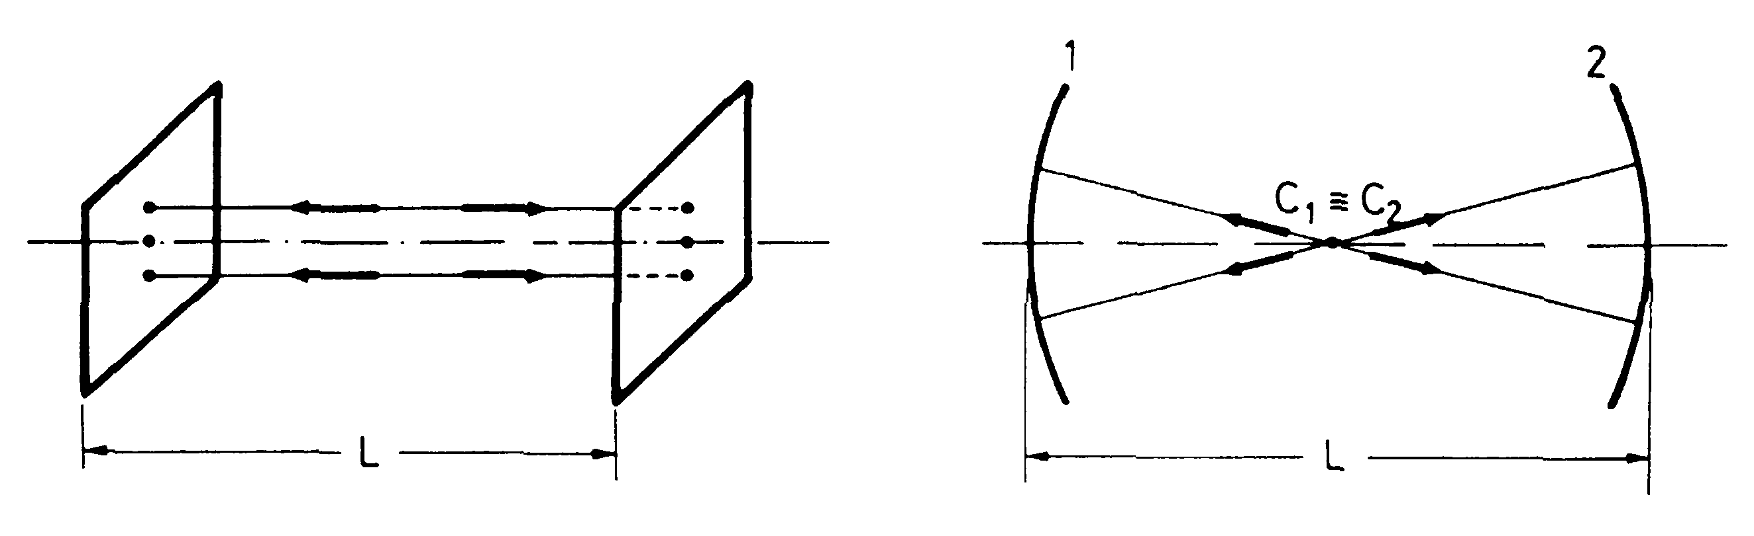
Laser resonator
A resonator is consist of two mirrors standing face to face with distance of d. therefore, the light ray travels two times through free space and reflect two time from mirrors. That means, the optical element which repeats consists of two propagation through free space and reflection from two mirrors.

Slide 63
Stability criterion:

Slide 65

A g₁, g₂ stability diagram for a general spherical resonator. The stable region corresponds to shaded parts in the figure; dashed curves correspond to the possible confocal resonators.

Slide 67


Slide 69

Flat mirror is mounted at the focal point of the spherical mirror

Slide 70

Flat mirror is mounted at the center of the spherical mirror

Slide 71
A resonator consisting of two parallel plane mirrors is always stable regardless of the length of the resonator.
In such a resonators, the beams parallel to the optical axis will remain within the resonators and back to the same position after one round trip. those beams which deviate from the optical axis will give up the laser medium as loss.

Slide 72
Nonlinear susceptibility
When a medium is placed in an applied external electric field, the electron cloud is deformed leading to create a dipole moment due to electric force arising from Coulomb law.
The induced polarization can be written as a function of applied electric field using the Tylor expansion:

Slide 73
The second order susceptibility is about 8 order of magnitude smaller than the first order . Thus, for common light sources where the light intensity is low the second and also other terms in polarization expansion is negligible with respect to the first term. Therefore:
It means that the polarization is a linear function of the applied electric field. The area of optics in which this approximation is held is called linear optics.
When a medium interact with high enough intense light the other terms in Tylor expansion of polarization versus electric field is no longer negligible and thus the polarization is a nonlinear function of applied electric field. This area of optics is called nonlinear optics.

Slide 74
Lorentz model
Consider an atom with electrons bound to the nucleus in much the same way as a small mass can be bound to a large mass by a spring. This is the Lorentz model.
The net force applied to the electron in an oscillating external electric field considering a damp factor is:
k is the spring constant, m is the electron mass, Γ is the damping factor, e is the electron electric charge and E is the applied electric field
The motion of an electron bound to the nucleus is then:

Slide 75
The oscillation amplitude of electron is then derived as:
Then the dipole moment of the oscillating electron can be written:
The polarization in then given by:
The polarization oscillates with frequency of ω thus the atom radiate only with frequency of ω. this explain the scattering and reflecting

Slide 76


Now the first order (linear) susceptibility can be derived as:
From which the linear refractive index and linear absorption coefficient can be calculated.

Slide 77

we extend the Lorentz model by allowing the possibility of a nonlinearity in the restoring force exerted on the electron. The details of the analysis differ depending upon whether or not the medium possesses inversion symmetry.
Non-centro-symmetric Media
the potential energy function is of the form
Anharmonic Oscillator
Then the restoring force is given by:
And then the polarization posses a nonlinear term as:

Slide 78








$$\frac{1}{2}k x^{2}$$
E
$$\frac{1}{2}k x^{2}−\frac{1}{3}A x^{3}$$
P
$$\frac{1}{2}k x^{2}+\frac{1}{3}A x^{3}$$
$$\frac{1}{2}k x^{2}$$
P
E

Slide 80
Centro-symmetric Media
the potential energy function is of the form which is symmetric under the operation of
Anharmonic Oscillator
Then the restoring force is given by:
For centrosymmetric it can be shown that the first nonlinear term appeared in the polarization is of the third order

Slide 81








$$U=\frac{1}{2}k x^{2}$$
$$U=\frac{1}{2}k x^{2}−\frac{1}{4}B x^{4}$$
$$U=\frac{1}{2}k x^{2}+\frac{1}{4}B x^{4}$$
P
$$U=\frac{1}{2}k x^{2}$$
E

Slide 83
Kerr Effect
Complex Refractive index:
Both refractive index and susceptibility are complex

Slide 84
Refractive Index =Real part of complex refractive index:
Linear refractive index
Nonlinear refractive index

Slide 85

Self focusing: n₂ > 0
Self focusing
Higher refractive index
lower refractive index

Slide 86
Self focusing: n₂ > 0
Self-Focused beam
Gaussian Input beam
Nonlinear Sample

Slide 87




Shorter L
Lower n
shorter optical path
Higher n
longer L
Self-focusing
Longer optical path
∆ = n L
Lower n
Higher n
Longer optical path
Lower n
Shorter L
Self-defocusing
shorter optical path
Higher n
longer L

Slide 88
Two-photon Absorption
Non-degenerate process
Degenerate process
ω₂
Excited state
Excited state
ω
Virtual state
ω₁
Virtual state
ω
Ground state
Ground state

Slide 89
Linear absorption coefficient
Two-photon absorption coefficient

Slide 90

Linear +nonlinear absorption
Beer–Lambert law
Linear absorption

Slide 91



Nonlinear phenomena and their Applications
Higher harmonic generation:
second harmonic generation (SHG): in this process two photons of the same frequency are annihilated and one photon at double frequency is created.
SHG
THG

Slide 92
The electric field oscillate at frequency ω
Optical Rectification. Non-oscillating term of polarization. Charge separation caused by high intensity light beam
Oscillating term at frequency ω. This terms is the origin of reemitting leading to normal scattering.
This term shows the contribution of nonlinear polarization oscillating at frequency 2 ω which is the origin of second harmonic generation.

Slide 93
Optical Parametric Amplification
in this process photon at new frequencies can be generated. Devices such as Optical Parametric Oscillator (OPO) and Optical Parametric Amplifier (OPA) work based on this phenomena. When two intense laser beam with different frequencies travel through a special nonlinear crystal, two different processes might be occurred depending on the system alignment
sum frequency generation: frequency of the new generated photon equals to sum of the two incident photons
difference frequency generation: frequency of the new generated photon equals to difference of the two incident photons

Slide 94
Optical Rectification.
Second harmonic generation (SHG).
Sum frequency generation (SFG).
Difference frequency generation (DFG).

Slide 95


Slide 96
Some typical applications of sum frequency generation are:
generation of red light (→ red lasers), e.g. by mixing the outputs of a 1064-nm Nd:YAG laser and a 1535-nm fiber laser, resulting in an output at 628 nm
generation of ultraviolet light, e.g. by mixing the output of a 1064-nm Nd:YAG laser with frequency-doubled light at 532 nm, resulting in 355-nm UV light

Slide 97
Some typical applications of difference frequency generation are:
generation of light around 3.3 μm by mixing 1570 nm from a fiber laser and 1064 nm
generation of light around 4.5 μm by mixing 860 nm from a laser diode and 1064 nm

Slide 98
Third Harmonic Generation

Slide 99
این جمله قطبش غیر خطی دارای 216=6³ جمله است. در آنها جملاتی شامل هارمونیک سوم هر یک از بسامدها تابش ورودی به محیط غیر خطی و همچنین بسیار بسامدهای تولید شده متفاوت خواهد بود:

Slide 100
امپلیفایر فمتوثانیه
فمتو لیزر یک لیزر پالسی با طول پالس کمتر از پیکو ثانیه یعنی در محدوده چند فمتوثانیه تا چند صد فمتو ثانیه است.
روشهای پالسی کردن لیزر
Q-switching
Mode-locking
Q-switching
Rotating Mirrors
Electro-optic modulators
Pockels cell
Kerr cell
Acousto-optic modulator

Slide 101

مدهای طولی Longitudinal Mode
برای طول خاصی از یک تشدیدگر بسامدها یا طول موج های خاصی تشدید شده و بقیه تقویت نمی شوند.
منظور از مدهای طولی همان طول موجهایی هستند که عملا درون تشدیدگر تقویت می شوند.
L
هماهنگ اصلی
هماهنگ دوم
هماهنگ سوم
هماهنگ چهارم

Slide 102

لیزرهای Ti-Sapphire معروفترین فمتولیزرها هستند که کوتاهترین پالسها را تولید می کنند.
پهنای طیف تابشی کریستال یاقوت کبود بیش از 200 نانومتر است.
بیشینه تابش روی طول موج حدود 800 نانومتر است.
طول کاواک فمتولیزر Ti-Sapp حدود 2 متر است.
Ti-Sapphire crystal
Absorption and Emission Spectrum
طیف جذب و تابش کریستال
یاقوت کبود
خیلی ساده این عدد را شماره مد مرکزی بنامیم.
به عبارتی مرکز تابش هماهنگ شماره 5000000 است.

Slide 103
طول موج مد مجاور مد مرکزی. اختلاف کمتر از 0.0002 نانومتر است که با هیچ طیف سنجی قابل تفکیک نیست درنتیجه طیف را پیوسته مشاهده می کنیم.
تعداد مدهای تشدیدی در بازه طول موجی 700 تا 900 نانومتر
درون رزوناتور با طول 2 متر
اختلاف بسامد مدهای مجاور.
این مقدار دقیقا مساوی تکرار پالس لیزر یعنی عکس فاصله بین پالسها (زمان یک رفت و برگشت کامل درون رزناتور) است.

Slide 104

L=2 m
اختلاف بسامد مدهای مجاور
Ti-sapp
تکرار پالس 75 مگا هرتز
فاصله بین پالسها 13.3 نانوثانیه
پهنای طیف 10¹³×9.375 هرتز، 200 نانومتر
تعداد مدهای تشدید شده 1250000
طول پالس حدود 10 فمتوثانیه (متناسب با عکس پهنای طیف)
طول رزوناتور تعیین کننده فاصله بسامدی مدها، تکرار پالس لیزر، فاصله زمانی بین پالسها و تعداد کل مدهای تشدید شده است.
فاصله بین پالسها
طول پالس
هرگاه تمام مدها همفاز باشد حاصل برهمنهی آنها دارای چنین شدتی خواهد شد که نشان دهنده خروجی پالسی می باشد

Slide 105


Mode-locking قفل شدگی مدها
فاصله بین پالسهای متوالی
فرض کنیم که امواج دارای فاصله بسامدی یکسان هستند:
تمام امواج هم دامنه و همفاز فرض شده اند:
طول پالس

Slide 107

Kerr Lens Mode-Locked Ti-Sapphire femto-laser
Second Harmonic of Nd-YAG Laser
5 W – CW Laser

Slide 108


femto-Oscillator
femto-Amplifier
112 nm
43 nm

Slide 109


Chirped pulse Amplification
قرار است انرژی پالس 150000 بار تقویت گردد. اگر طول پالس ثابت بماند شدت نیز 150000بار افزایش یافته و باعث آسب دیدن کریستال خواهد شد.
برای جلوگیری از آسیب اپتیک بکار رفته در امپلیفایر طول پالسهای خروجی از اسیلاتور را قبل از ارسال به قسمت امپلیفار افزایش می دهند. این کار با انتشار باریکه لیزر از درون یک قطعه شیشه ای به طول چند سانتی متر انجام می گیرد. پالسهای خروجی از استرچر چیرپ شده هستند یعنی طیف تابش تابع زمان است. طول موجهای بلندتر در ابتدای پالس و طول موجهای کوتاهتر از انتهای پالس مشاهده می شوند.
Fourier transformed
fs pulses
Chirped pulse
Fourier transformed
and amplified fs pulses
I
Chirped ps pulses
Chirped amplified Pulses
t

Slide 110


Slide 111

Amplifying Section
قلب قسمت امپلیفایر یک کریستال Ti-sapphire به ابعاد حدود است. این کریستال در یک محفظه خلا و بر روی یک خنک کننده پلتیر قرار دارد. کریستال توسط یک لیزر پالسی با تکرار پالس یک کیلو هرتز، طول پالس حدود 250 نانوثانیه، انرژی پالس 10 میلی ژول و طول موج 532 نانومتر پمپ می شود.
Retro reflector
پالسهای لیزر اسیلاتور 9 بار از درون این کریستال عبور کرده و تقویت می گردد
Concave Mirror
Concave Mirror
Second Harmonic
Nd-YAG Laser
10 W, 250 ns, 1kHz
Ti-sapp
Crystal
Pump Beam
532 nm
Pockels cell
Mirror

Slide 112
1st 4-pass
Retro reflector
Concave Mirror
3
Concave Mirror
1
2
4
4
2
1
3
Crystal
Pump Beam
Mirror
Pockels cell
Seed Beam

Slide 113


قطار موج تابش ورودی به امپلیفایر
تکرار پالس 73.85 مگا هرتز
زمان جدایی پالسها 13.54 نانوثانیه
قطار موج پس از چهار بار عبور از درون کریستال
پوش این سیگنال شکل پالس لیزر پمپ 250 نانوثانیه را نشان می دهد.

Slide 114
2nd 4-pass
5th to 8th pass
Retro reflector
Concave Mirror
Concave Mirror
6
8
5
7
7
8
5
6
Crystal
Pump Beam
Pockels cell
Polarizer
Mirror

Slide 115
9th pass
Compressor
Concave Mirror
Concave Mirror
9
Crystal
8
Pump Beam

Slide 116
Compressing Section
2nd Prism pair
Mirror
1st Prism pair
سیستم فشرده ساز از دو جفت منشور از شیشه SF₁₁ تشکیل شده است. در این شیشه تغییرات ضریب شکست بر حسب طول موج زیاد است. چیدمان به گونه ای است که پس از پاشیده شدن باریکه لیزری در اولین منشور راه اپتیکی برای مولفه قرمز نسبت به مولفه آبی بیشتر است در نتیجه در رفت و برگشت زمان بیشتری صرف می کند و همزمان با مولفه آبی می شود.

Slide 117
Compressing the pulse using prism pair
تابش پیکوثانیه

Slide 118
Compressing the pulse using prism pair
fs Pulses

Slide 119


Slide 120


Slide 121






Z-scan Technique
Citations: 7226
50th anniversary of NLO

Slide 122
Z-scan Technique
Closed Aperture – Open Aperture
Closed Aperture: To determine the nonlinear refraction.
The transmitted power through a small aperture is detected.
Open Aperture: to determine the nonlinear absorption.
The transmitted power through the sample is entirely collected.

Slide 123

Closed Aperture Z-scan setup

Slide 124







Closed Aperture Z-scan setup
n₂>0
1.The laser beam is divided by a beam splitter.
2. Focusing lens &translating the sample.
3. The Aperture transmittance is measured by a diode.
4. detecting signals by a picoscope.
5. The computer handles the movement of the translating stage as well as the whole data acquisition process

Slide 125
10%
n₂ < 0
n₂ >0
Aperture Transmittance
0
-10%
-1
0
-
0
1
5
5
0
z/z₀

Slide 126

Open Aperture Z-scan setup

Slide 127


Open Aperture Z-scan setup
1. The laser beam is divided by a beam splitter
2. Focusing lens & translating the sample.
3. The transmittance is entirely collected by a diode
4. both signals measured by a picoscope
5. The computer handles the movement of the translating stage as well as the whole data acquisition process

Slide 128

Z-scan setup
Determining both nonlinear absorptivity and refractivity

Slide 129

Separation of NL Absorption and NL Refraction
C.A. divide by O.A.
O.A. signal
C.A. signal

Slide 130

moves toward the focus >>> beam diameter decreases >>> the laser intensity increases >>> self-focusing >>> focusing the laser beam earlier >>> beam broadening on the aperture plane >>> decrease in transmittance.
After the focus >>> self-focusing tends to less diverging >>> beam narrowing on the aperture plane >>> increase in transmittance.
n₂ >0

Slide 131
Focusing lens
Aperture
NL Sample
Laser Beam
Δz
Aperture
Focusing lens
NL Sample
Laser Beam
Δz
Aperture
Focusing lens
NL Sample
Laser Beam
Δz

Slide 132

Z-Scan setup
M. Sheik-Bahae, …, & E.W. Van Stryland, IEEE J. Quantum Electron. 26, 760 (1990)

Slide 133
“Closed” aperture Z-Scan for n₂ > 0
Aperture
Focusing lens
NL Sample
Laser Beam
Δz

Slide 134
“Closed” aperture Z-Scan for n₂ > 0
Aperture
Focusing lens
NL Sample
Laser Beam
Δz

Slide 135
“Closed” aperture Z-Scan for n₂ > 0
Aperture
Focusing lens
NL Sample
Laser Beam
Δz

Slide 136
“Closed” aperture Z-Scan for n₂ > 0
Aperture
Focusing lens
NL Sample
Laser Beam
Δz

Slide 137
“Closed” aperture Z-Scan for n₂ > 0
Aperture
Focusing lens
NL Sample
Laser Beam
Δz

Slide 138
“Closed” aperture Z-Scan for n₂ > 0
Aperture
Focusing lens
NL Sample
Laser Beam
Δz

Slide 139
“Closed” aperture Z-Scan for n₂ > 0
Aperture
Focusing lens
NL Sample
Laser Beam
Δz

Slide 140
“Closed” aperture Z-Scan for n₂ > 0
Aperture
Focusing lens
NL Sample
Laser Beam
Δz

Slide 141
“Closed” aperture Z-Scan for n₂ > 0
Aperture
Focusing lens
NL Sample
Laser Beam
Δz

Slide 142
“Closed” aperture Z-Scan for n₂ > 0
Aperture
Focusing lens
NL Sample
Laser Beam
Δz

Slide 143
“Closed” aperture Z-Scan for n₂ > 0
Aperture
Focusing lens
NL Sample
Laser Beam
Δz

Slide 144
“Closed” aperture Z-Scan for n₂ > 0
Aperture
Focusing lens
NL Sample
Laser Beam
Δz

Slide 145
“Closed” aperture Z-Scan for n₂ > 0
Aperture
Focusing lens
NL Sample
Laser Beam
Δz

Slide 146
“Closed” aperture Z-Scan for n₂ > 0
Aperture
Focusing lens
NL Sample
Laser Beam
Δz

Slide 147
“Closed” aperture Z-Scan for n₂ > 0
Aperture
Focusing lens
NL Sample
Laser Beam
Δz

Slide 148
“Closed” aperture Z-Scan for n₂ > 0
Aperture
Focusing lens
NL Sample
Laser Beam
Δz

Slide 149
“Closed” aperture Z-Scan for n₂ > 0
Aperture
Focusing lens
NL Sample
Laser Beam
Δz

Slide 150

Closed aperture Z-scan Signal
Aperture normalized transmittance (T ) versus sample position (z).
y
x'y': observation plane
y'
x
x'
L
z
z'

Slide 151
3rd order nonlinearity:
Assuming no nonlinear absorption:
Incident electric field
Linear absorption factor
Phase change factor

Slide 152
y
x'y': observation plane
y'
x
x'
L
z
z'
Fresnel diffraction integral
Electric field on the aperture plane
Electric field exiting the sample

Slide 153
Gaussian Beam

Slide 154

Z-scan Signal

Slide 155



Z-scan Signal

Slide 156

Open aperture Z-scan Signal

Slide 157
Assuming CW
laser light

Slide 158

Assuming a temporally Gaussian pulse:

Slide 160

Open aperture Z-scan setup

